Slide 2
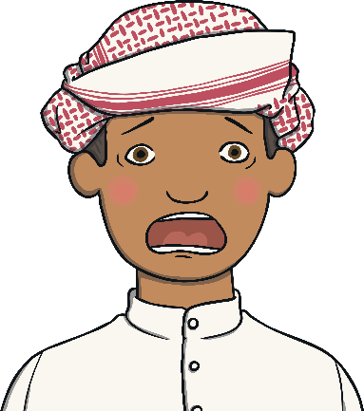
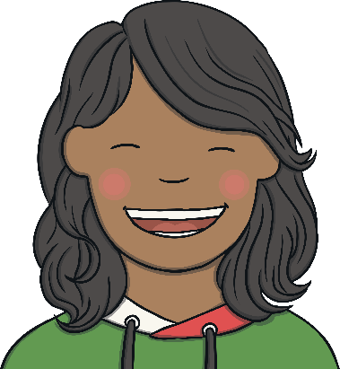
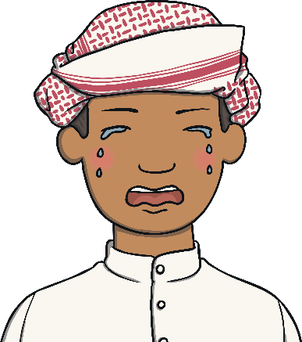
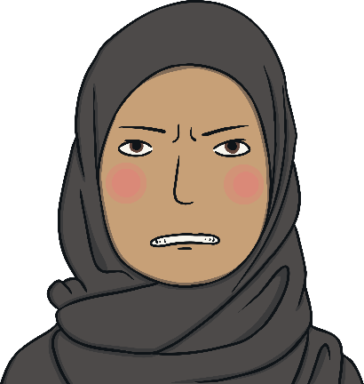
Feelings
Scared
Happy
Sad
Angry

Slide 3
How does this girl feel?
Why do you think she feels like this?
What makes you feel happy?
Photo courtesy of TriggerHappyDave (@flickr.com) - granted under creative commons licence – attribution

Slide 4
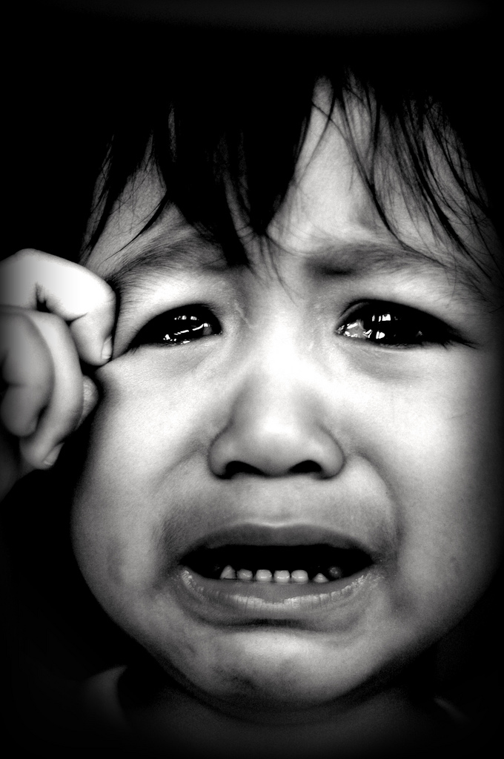
How does this boy feel?
Why do you think he feels like this?
What cheers you up when you feel sad?
Photo courtesy of mdpai75 (@flickr.com) - granted under creative commons licence – attribution

Slide 5
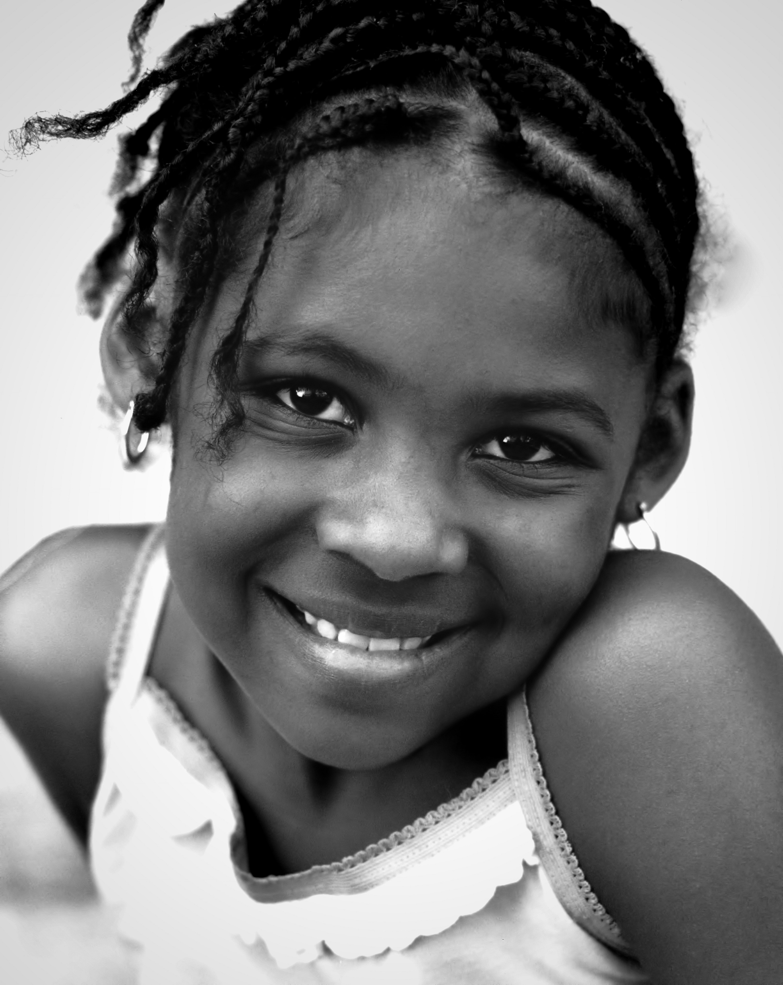
How does this girl feel?
Why do you think she feels like this?
What is another word for happy?

Slide 6
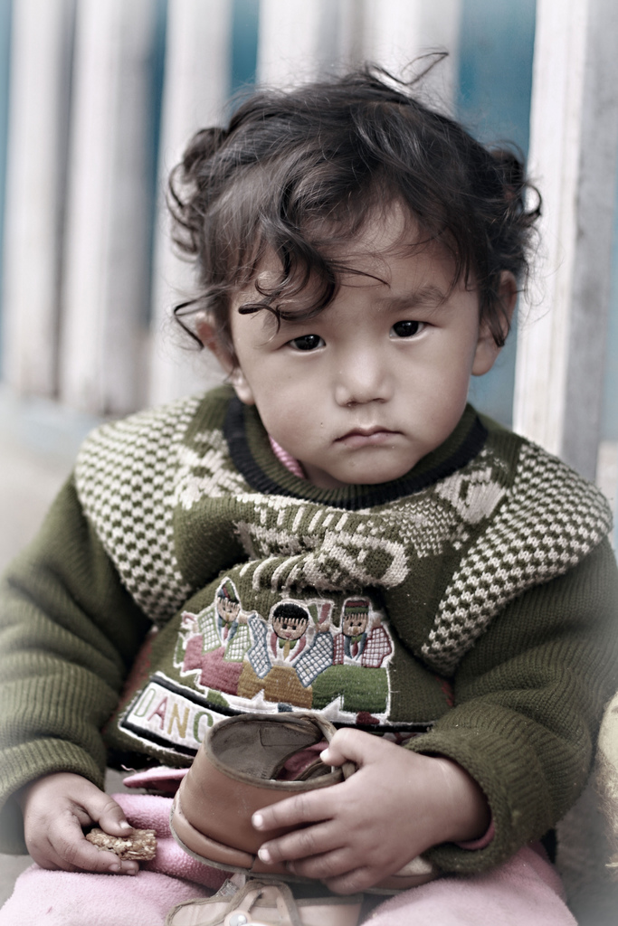
How does this boy feel?
Why do you think he feels like this?
What cheers you up when you feel sad?
Photo courtesy of emifaulk (@flickr.com) - granted under creative commons licence – attribution

Slide 7
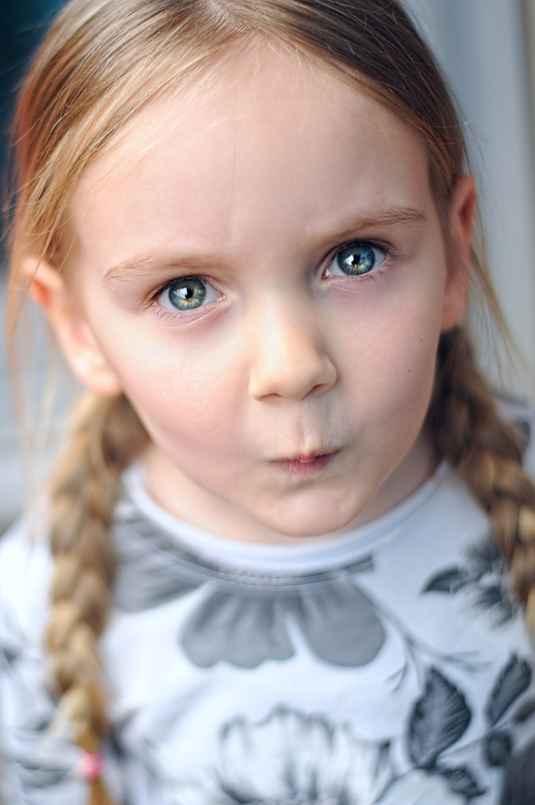
How does this girl feel?
Why do you think she feels like this?
What is another word for angry?

Slide 8
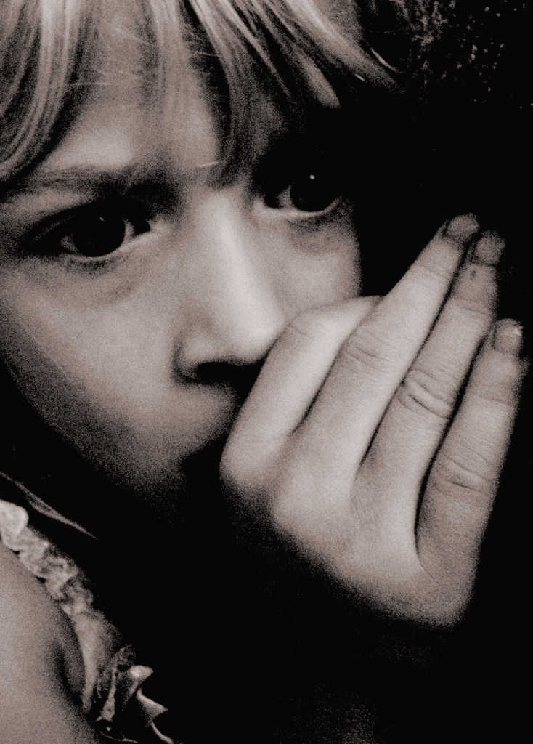
How does this girl feel?
Why do you think she feels like this?
What makes you scared?
Photo courtesy of Pink Sherbert Photography (@flickr.com) - granted under creative commons licence – attribution

Slide 9
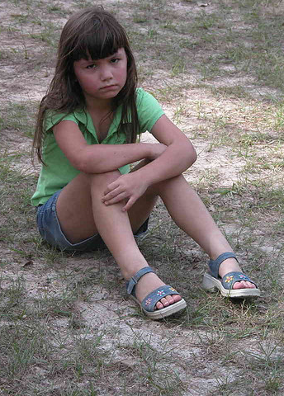
How does this girl feel?
Why do you think she feels like this?
What is another word for sad?
Photo courtesy of Tammra McCauley (@flickr.com) - granted under creative commons licence – attribution

Slide 10
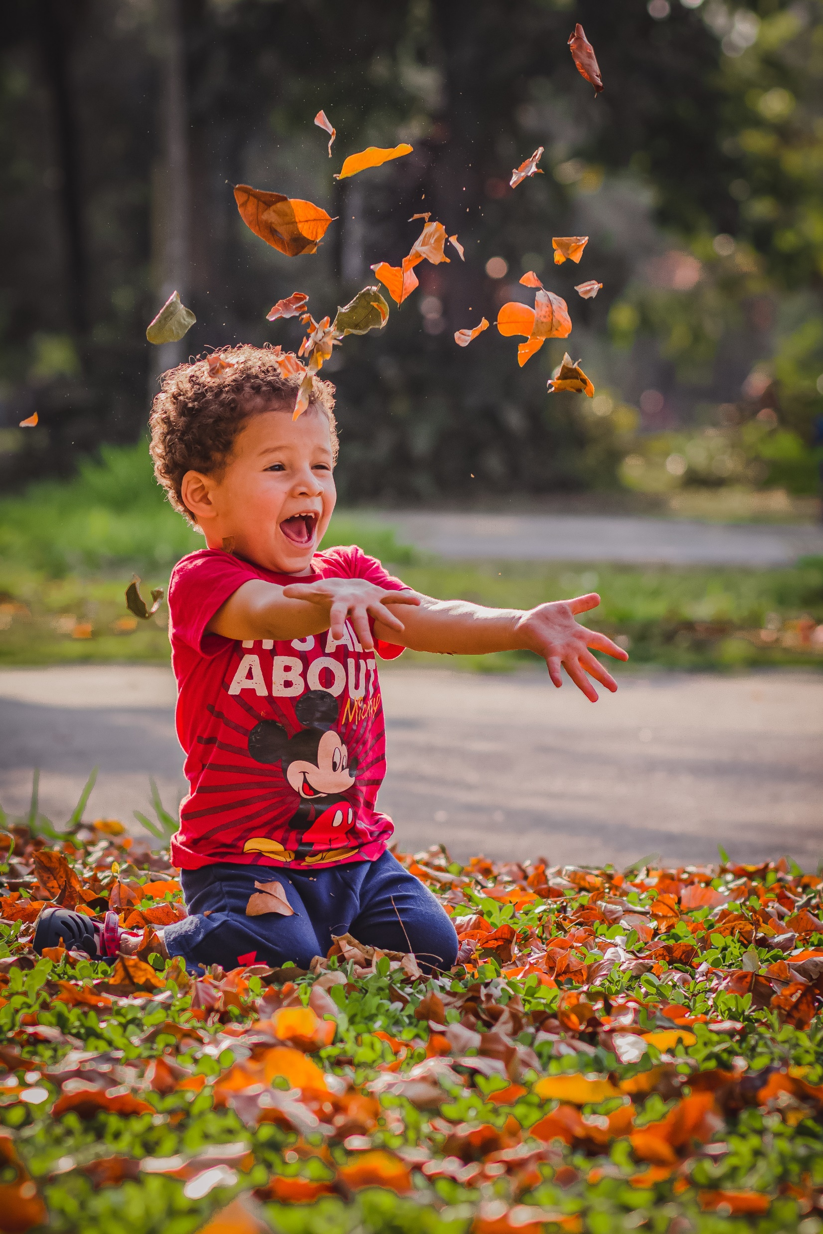
How does this boy feel?
Why do you think he feels like this?
What makes you feel happy?

Slide 11
Feelings
Scared
Happy
Sad
Angry
Are there any other emotions you feel?
Draw a happy, sad, angry and scared face.

