Slide 3
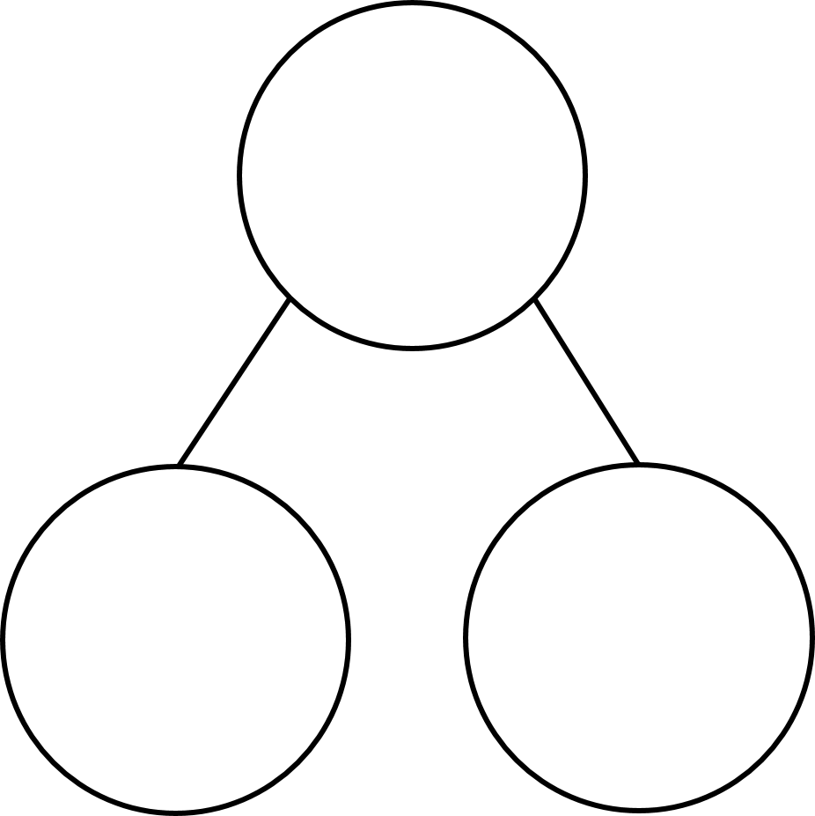

$\frac{\text{7}}{\text{7}}$ $=$ 1 $=$ $\frac{\text{5}}{\text{5}}$
2 $=$ $\frac{\text{14}}{\text{7}}$ $\frac{\text{10}}{\text{5}}$ $=$
$\frac{\text{7}}{\text{5}}$ $=$ whole $+$ fifths
d
$\frac{\text{4}}{\text{5}}$
$\frac{\text{6}}{\text{7}}$
$\frac{\text{2}}{\text{5}}$
$\frac{\text{2}}{\text{7}}$

Slide 4
5
$\frac{\text{7}}{\text{7}}$ $=$ 1 $=$ $\frac{\text{5}}{\text{5}}$
2 $=$ $\frac{\text{14}}{\text{7}}$ $\frac{\text{10}}{\text{5}}$ $=$
$\frac{\text{7}}{\text{5}}$ $=$ whole $+$ fifths
d
1
14
2
1
2
$\frac{\text{4}}{\text{5}}$
$\frac{\text{4}}{\text{7}}$
$\frac{\text{6}}{\text{7}}$
$\frac{\text{2}}{\text{5}}$
$\frac{\text{2}}{\text{5}}$
$\frac{\text{2}}{\text{7}}$

Slide 6
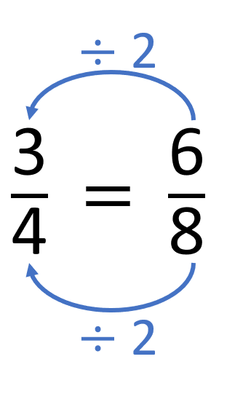
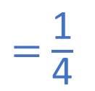
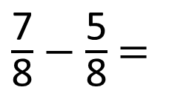
$\frac{\text{7}}{\text{8}}$ $−$ $\frac{\text{5}}{\text{8}}$ $=$
$\frac{\text{2}}{\text{8}}$
$=$ $\frac{\text{1}}{\text{4}}$
Have a think

Slide 7
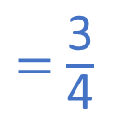
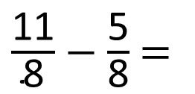
$\frac{\text{11}}{\text{8}}$ $−$ $\frac{\text{5}}{\text{8}}$ $=$
$\frac{\text{6}}{\text{8}}$
$=$ $\frac{\text{3}}{\text{4}}$

Slide 8
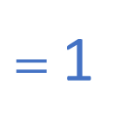
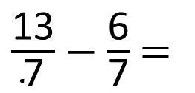
$\frac{\text{13}}{\text{7}}$ $−$ $\frac{\text{6}}{\text{7}}$ $=$
$\frac{\text{7}}{\text{7}}$
$=$ 1
Have a think

Slide 9
Have a go at questions 1 – 3 on the worksheet

Slide 10
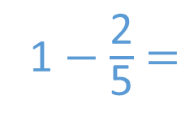
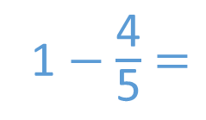
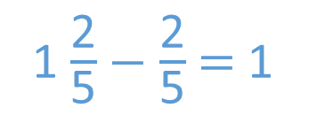
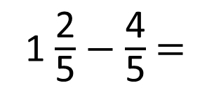
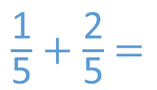
1 $\frac{\text{2}}{\text{5}}$ $−$ $\frac{\text{4}}{\text{5}}$ $=$
$\frac{\text{3}}{\text{5}}$
$\frac{\text{2}}{\text{5}}$
$\frac{\text{2}}{\text{5}}$
Method A
Method B
1 $\frac{\text{2}}{\text{5}}$ $−$ $\frac{\text{2}}{\text{5}}$ $=$ 1
1 $−$ $\frac{\text{4}}{\text{5}}$ $=$
$\frac{\text{5}}{\text{5}}$
$\frac{\text{1}}{\text{5}}$
1 $−$ $\frac{\text{2}}{\text{5}}$ $=$
$\frac{\text{3}}{\text{5}}$
$\frac{\text{5}}{\text{5}}$
$\frac{\text{3}}{\text{5}}$
$\frac{\text{1}}{\text{5}}$ $+$ $\frac{\text{2}}{\text{5}}$ $=$

Slide 11


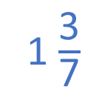
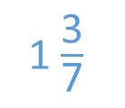
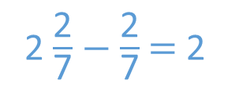
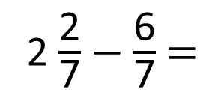
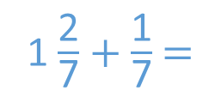
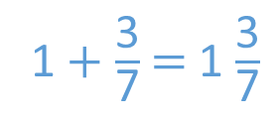
2 $\frac{\text{2}}{\text{7}}$ $−$ $\frac{\text{6}}{\text{7}}$ $=$
1 $\frac{\text{3}}{\text{7}}$
Have a think
$\frac{\text{2}}{\text{7}}$
$\frac{\text{4}}{\text{7}}$
Method A
Method B
2 $\frac{\text{2}}{\text{7}}$ $−$ $\frac{\text{2}}{\text{7}}$ $=$ 2
1 $−$ $\frac{\text{6}}{\text{7}}$ $=$
$\frac{\text{7}}{\text{7}}$
$\frac{\text{1}}{\text{7}}$
1 $−$ $\frac{\text{4}}{\text{7}}$ $=$
1 $\frac{\text{2}}{\text{7}}$ $+$ $\frac{\text{1}}{\text{7}}$ $=$
1 $\frac{\text{3}}{\text{7}}$
$\frac{\text{7}}{\text{7}}$
$\frac{\text{3}}{\text{7}}$
1 $+$ $\frac{\text{3}}{\text{7}}$ $=$ 1 $\frac{\text{3}}{\text{7}}$

Slide 12
Have a go at the rest of the questions on the worksheet

