Slide 1


French
Getting to Know You
Year One
French | Year 5 | Getting to Know You | When I Grow Up… | Lesson 2

Slide 2


Slide 3
Aim
I can use the simple future tense.
Success Criteria
I can use ‘je serai’ to refer to my future.
I can show how French future tense is different to English.
I can use the speaker’s body language to help me understand what they are saying.
I can listen and respond appropriately to what is said.

Slide 4

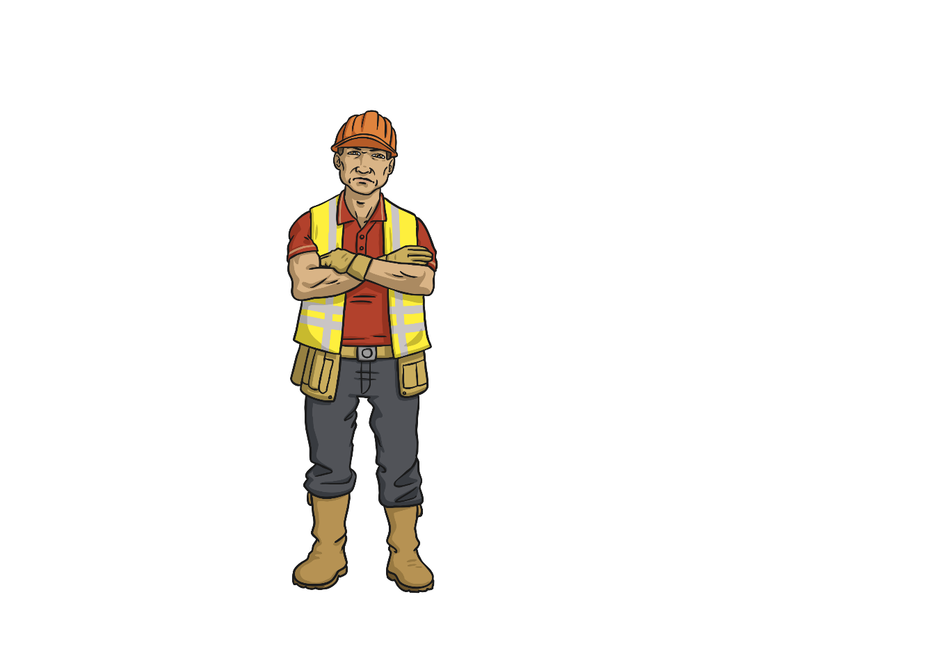
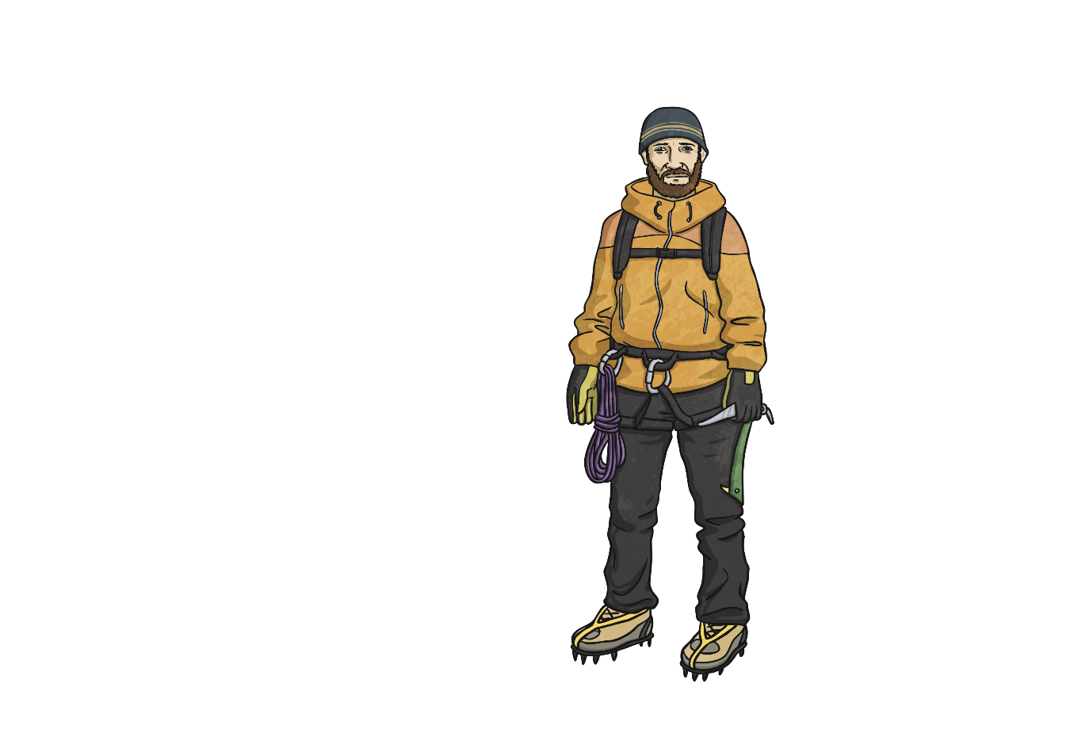
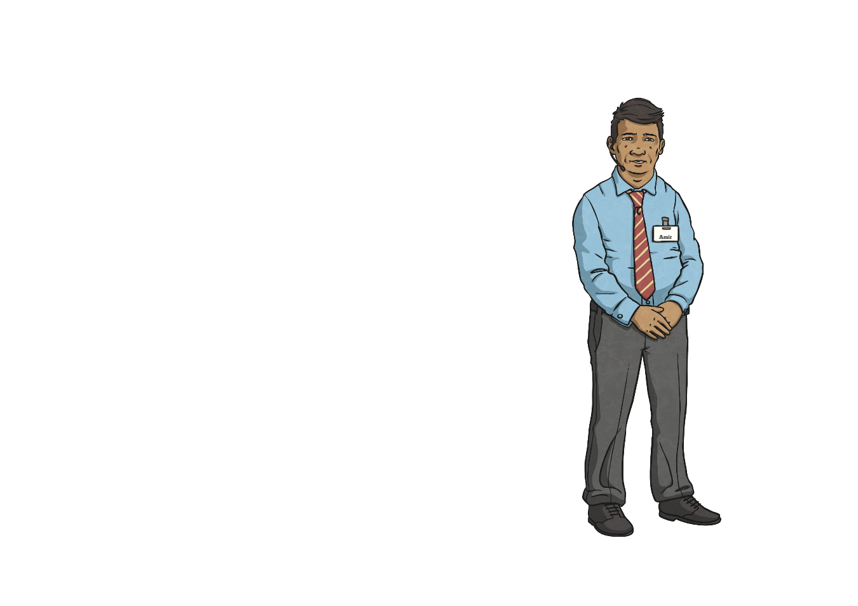
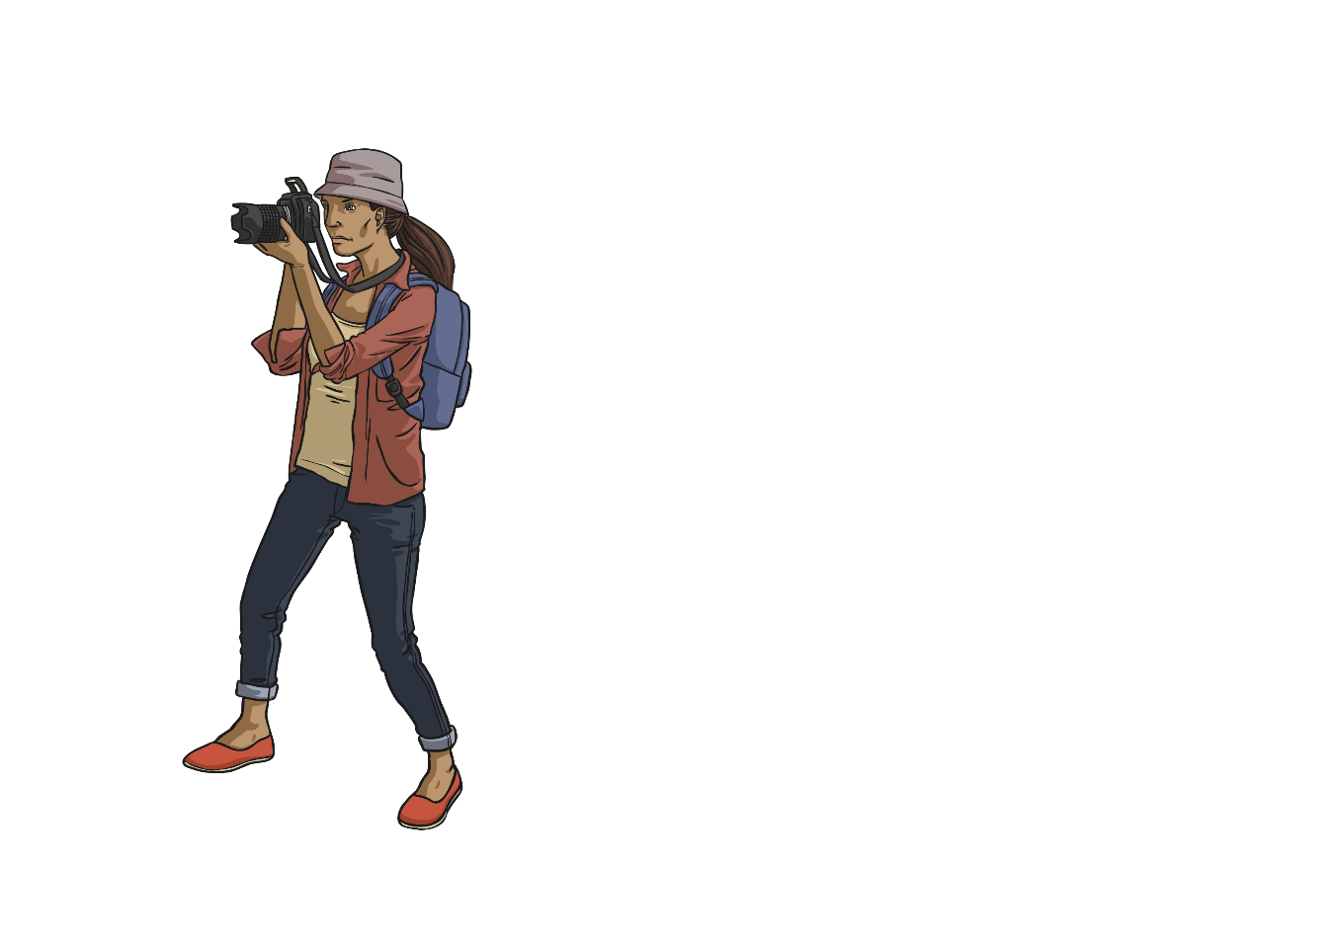
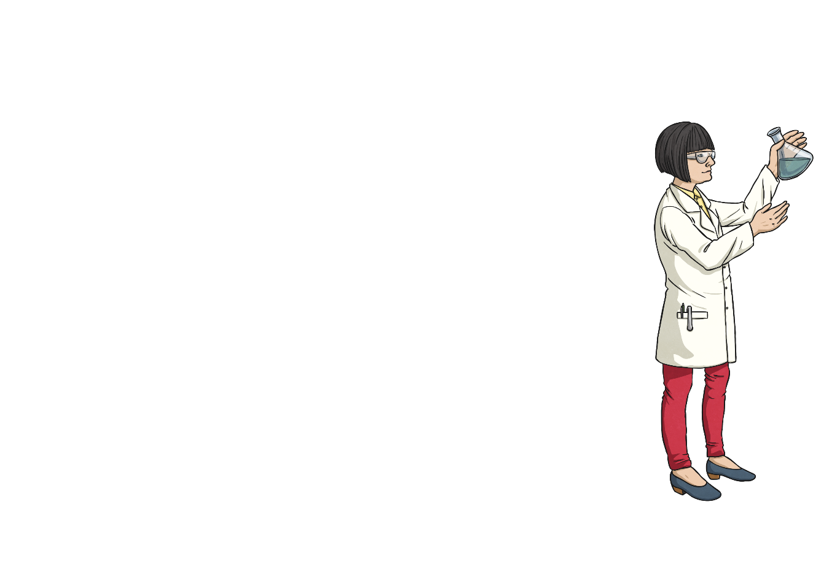
When I Grow Up...
What’s your ambition? Let’s compare ideas about what we’re going to do when we grow up!

Slide 5
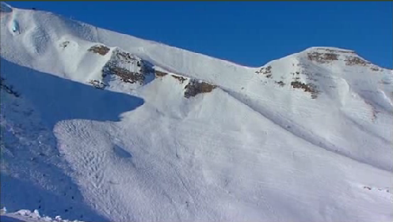
Le travail (Work)
Click to watch this video of some people at work in France.
Where do they work? What are their jobs?
You will need Flash Player for this to work
Did you catch any of the job names?

Slide 6


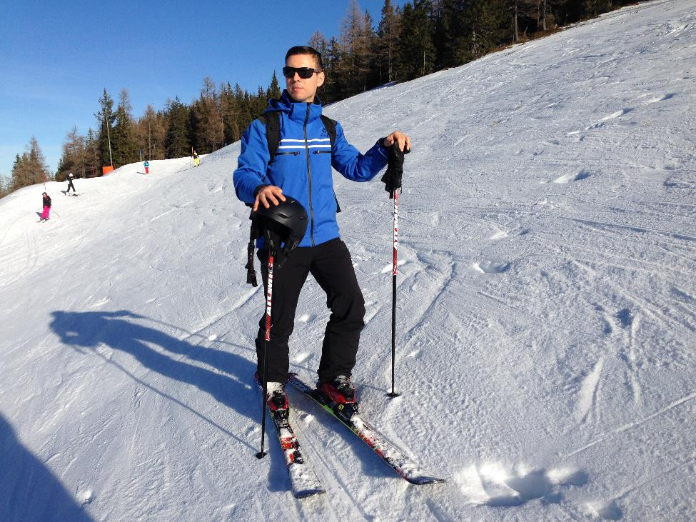
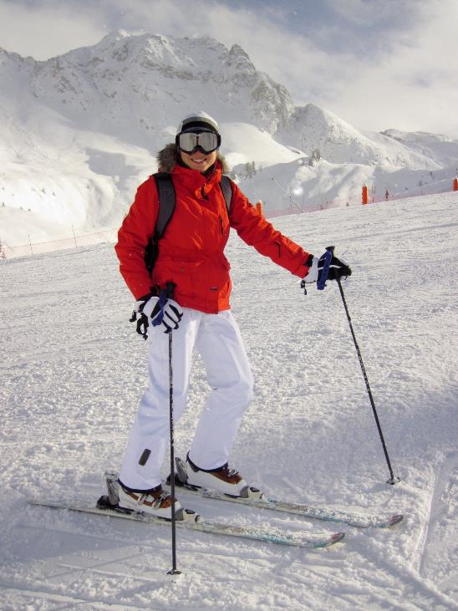
Les métiers (Jobs)
Click play buttons throughout to hear phrases and words.
Je suis moniteur de ski.
Je suis monitrice de ski.

Slide 7
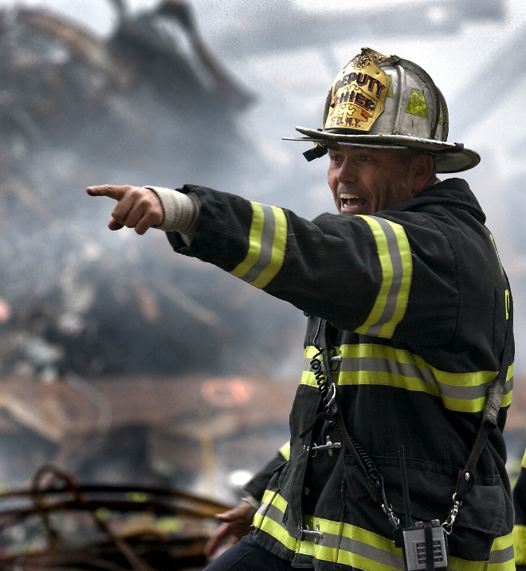
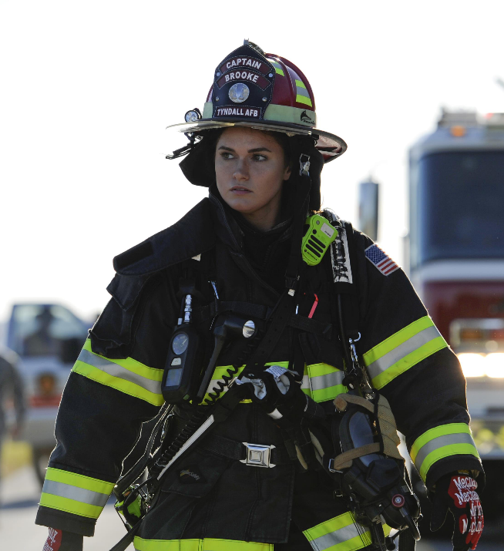
Les métiers (Jobs)
Je suis pompier.
Je suis pompier.
Photo courtesy of 325th Operations Group (@wikipedia.org) - granted under creative commons licence – attribution

Slide 8
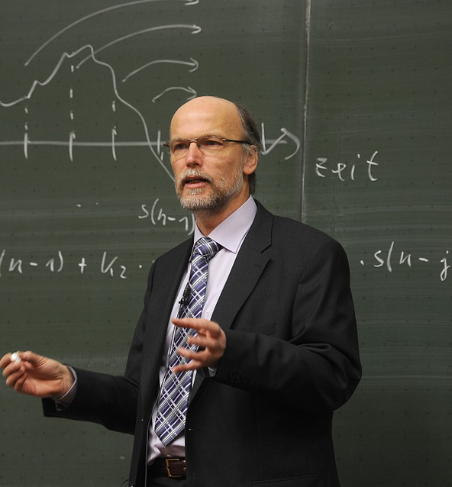
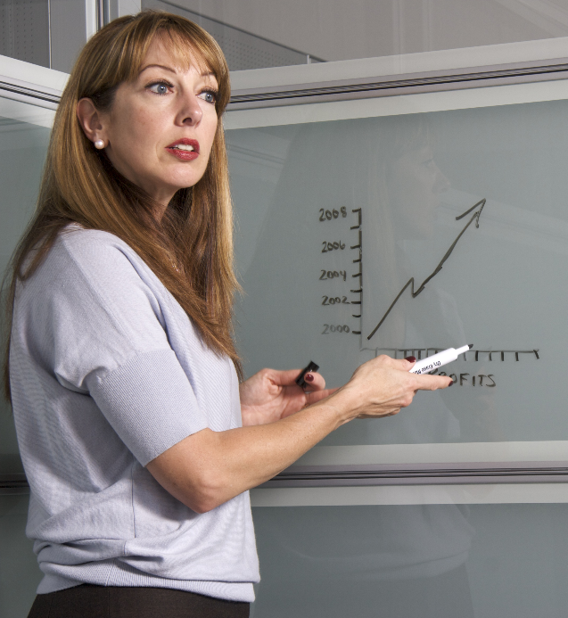
Les métiers (Jobs)
Je suis professeure.
Je suis professeur.

Slide 9
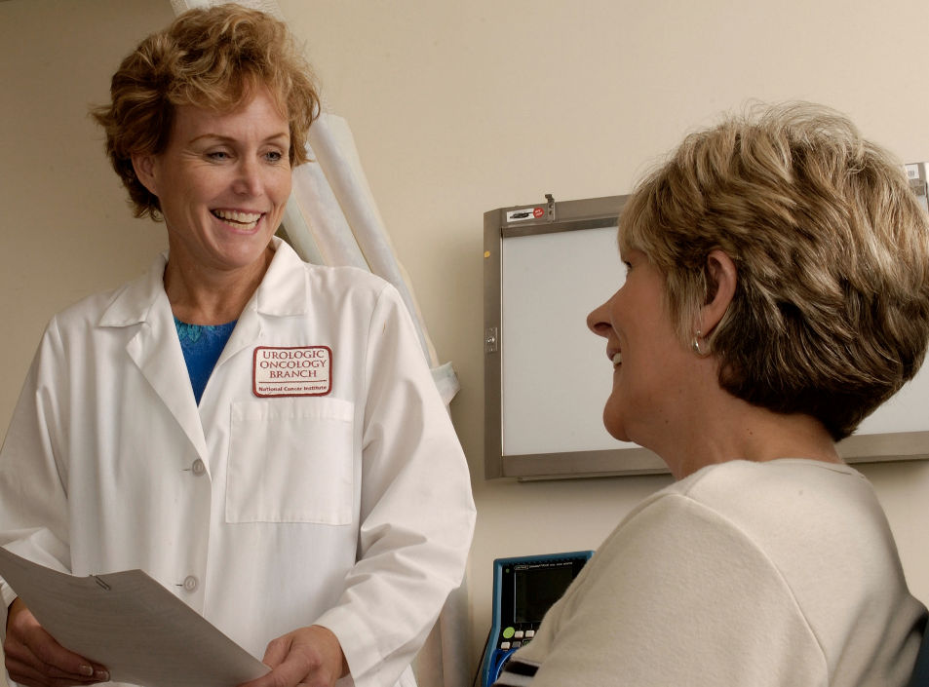
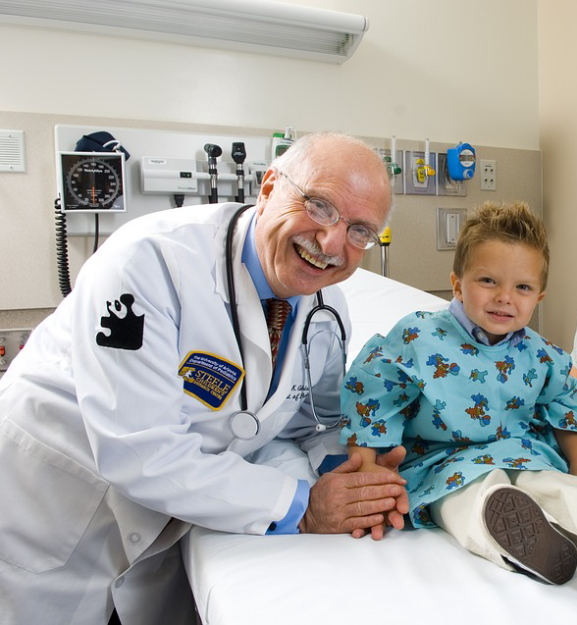
Les métiers (Jobs)
Je suis médecin.
Je suis médecin.
Photo courtesy of National Cancer Institute (@wikimedia.org) - granted under creative commons licence – attribution

Slide 10
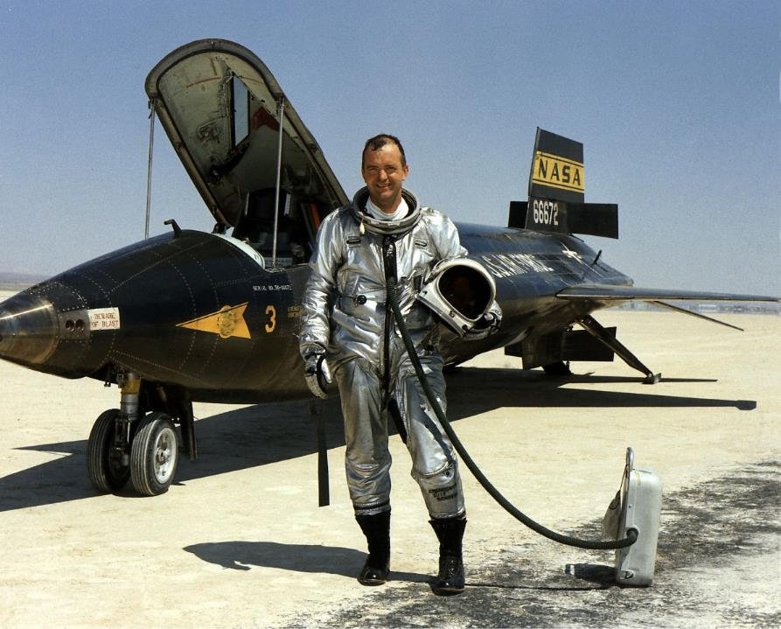
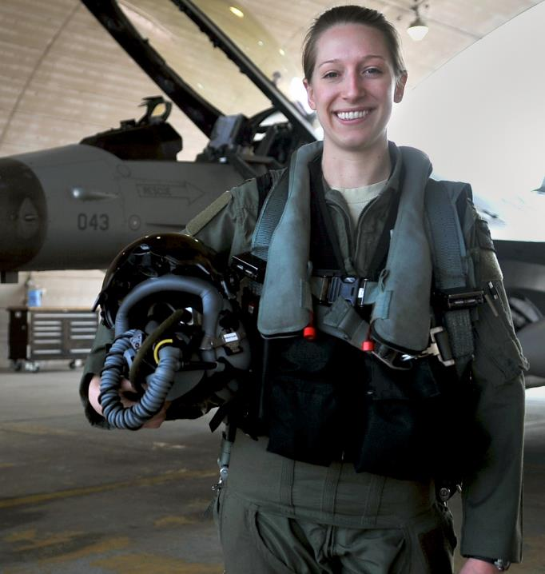
Les métiers (Jobs)
Je suis aviateur.
Je suis aviatrice.
Photo courtesy of NASA and Senior Airman Alexis Siekert (@wikimedia.org) - granted under creative commons licence – attribution

Slide 11
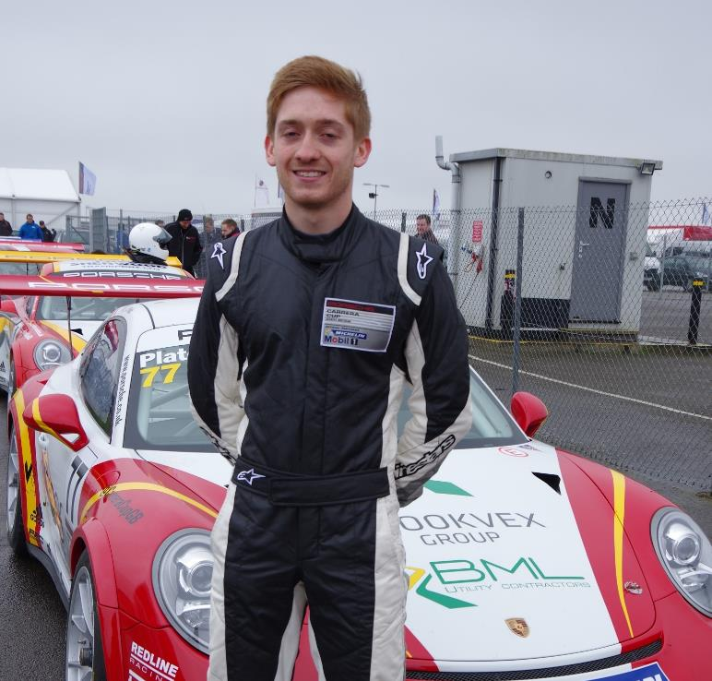
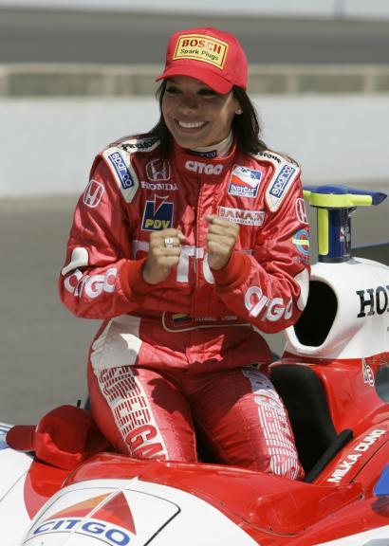
Les métiers (Jobs)
Je suis coureur automobile.
Je suis coureuse automobile.
Photo courtesy of davehamster and fotos pilotos (@flickr.com) - granted under creative commons licence – attribution

Slide 12
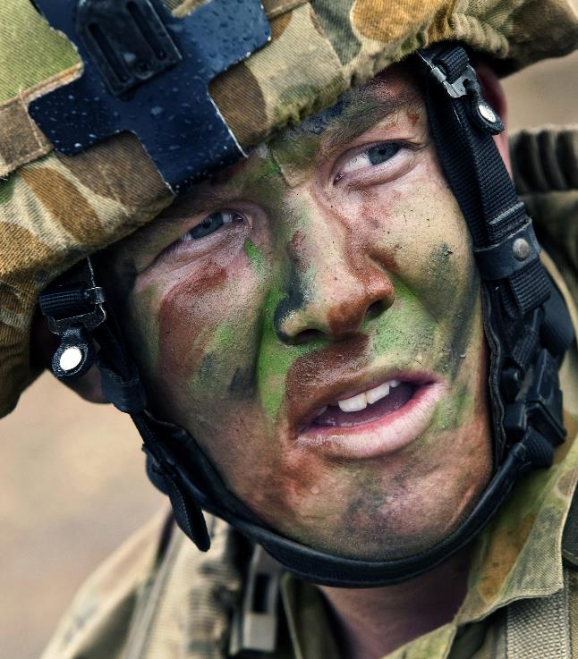
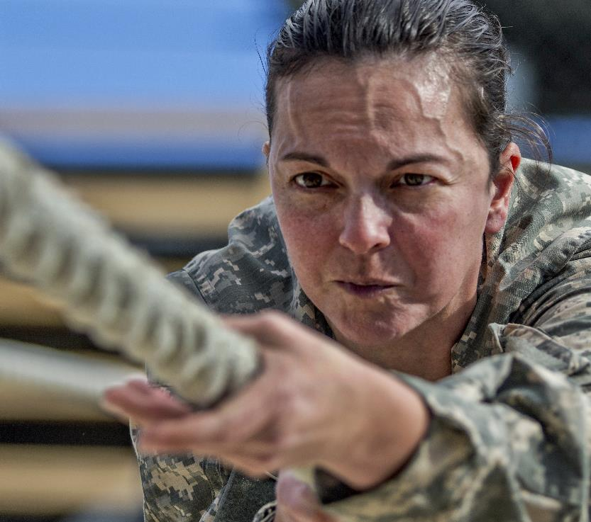
Les métiers (Jobs)
Je suis soldat.
Je suis soldat.

Slide 13
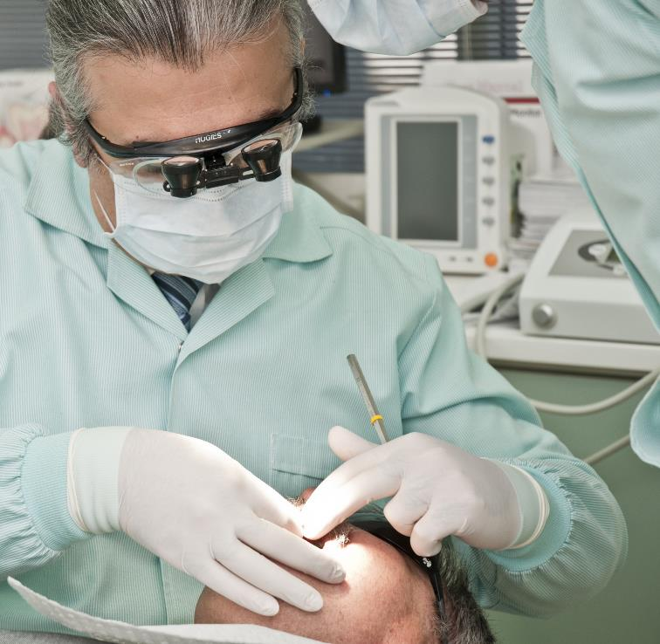
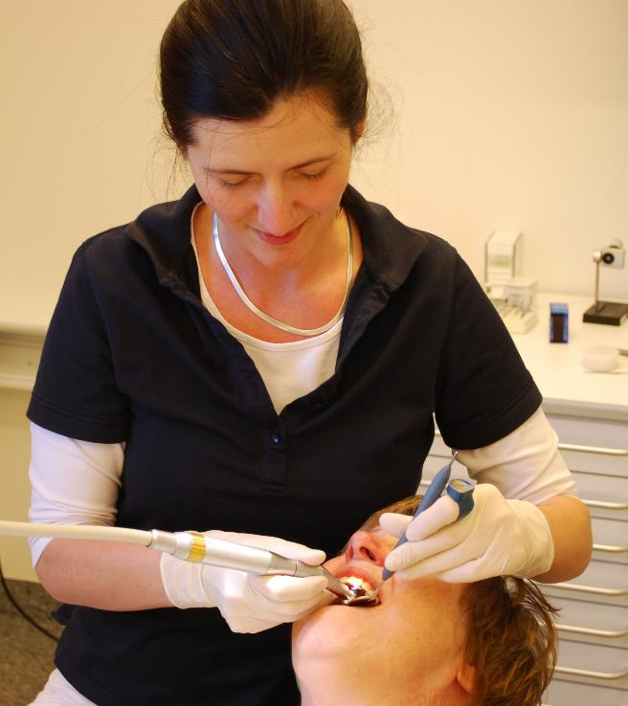
Les métiers (Jobs)
Je suis dentiste.
Je suis dentiste.
Photo courtesy of Erik Christensen (@wikimedia.org) - granted under creative commons licence – attribution

Slide 14
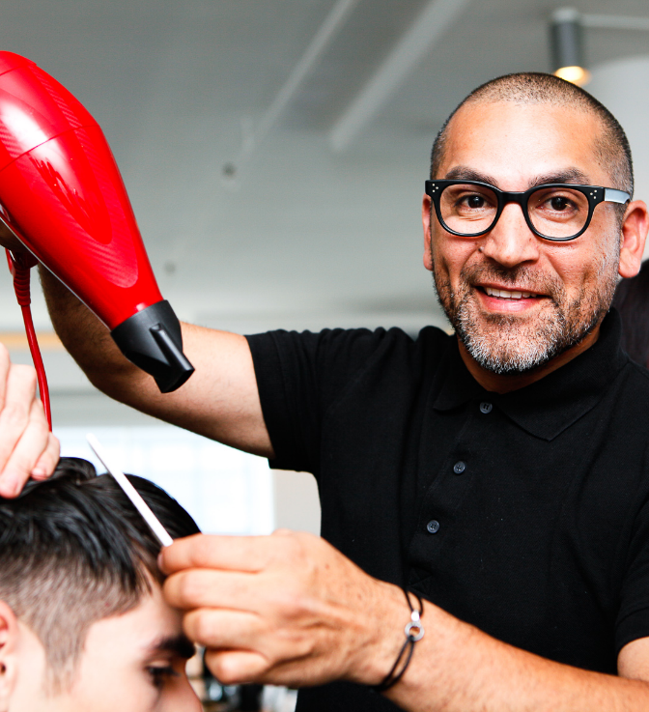
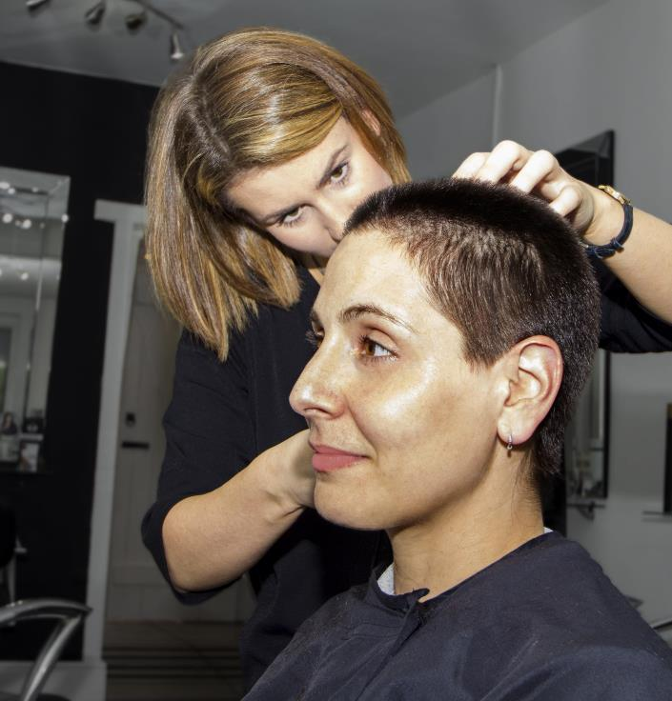
Les métiers (Jobs)
Je suis coiffeuse.
Je suis coiffeur.
Photo courtesy of gomainstream (@flickr.com) - granted under creative commons licence – attribution

Slide 15
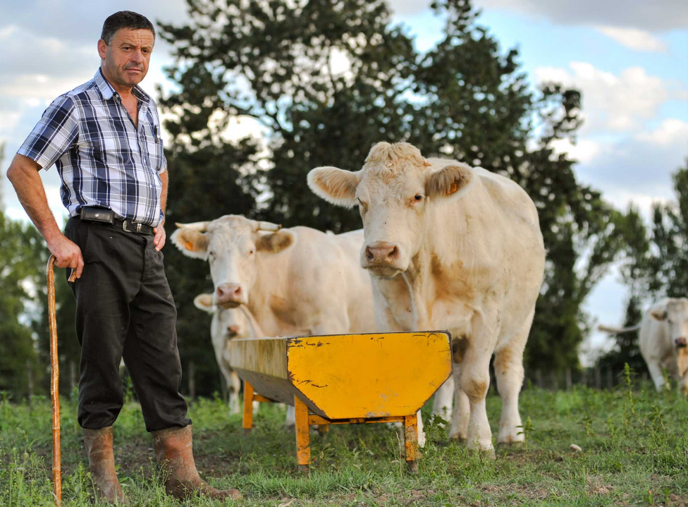
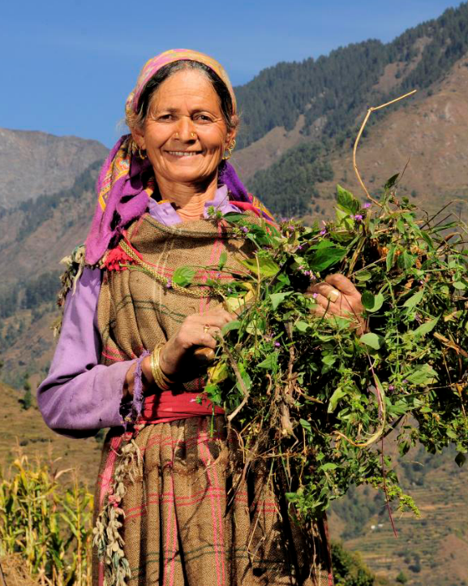
Les métiers (Jobs)
Je suis fermier.
Je suis fermière.
Photo courtesy of ciat (@flickr.com) - granted under creative commons licence – attribution

Slide 16
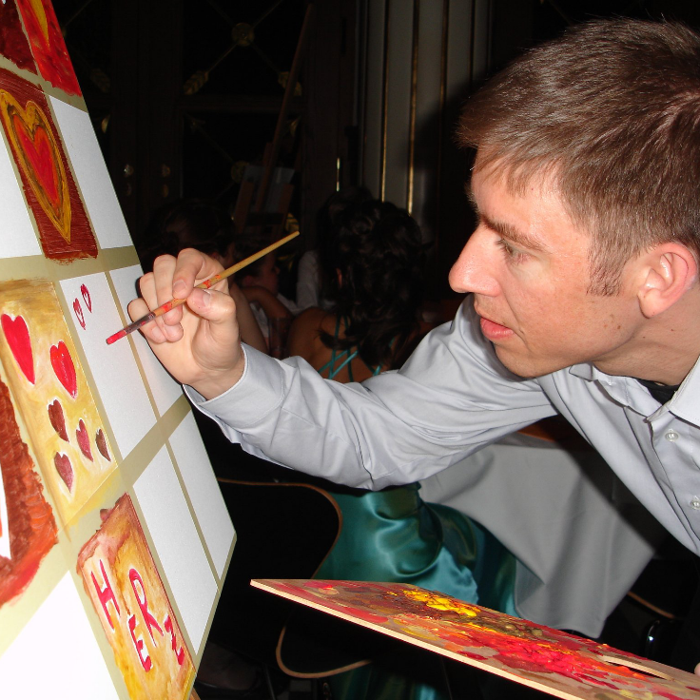
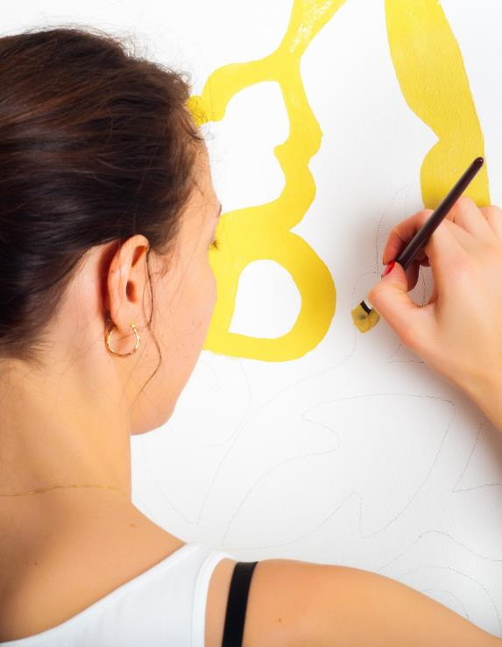
Les métiers (Jobs)
Je suis artiste.
Je suis artiste.

Slide 17
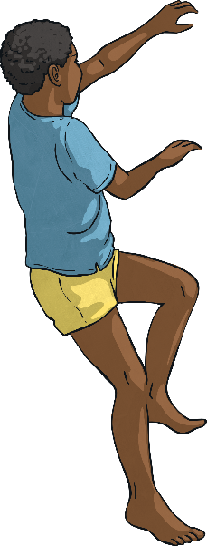
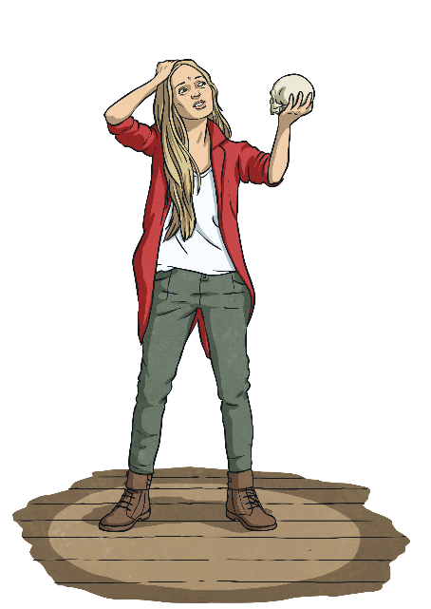
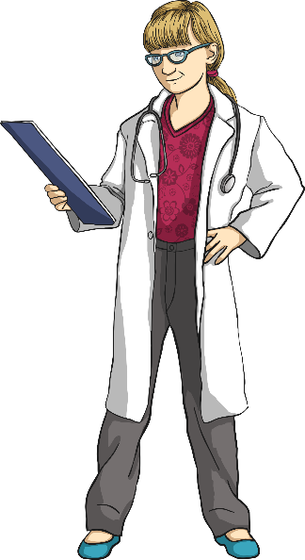
La grammaire du futur simple (Simple Future Tense)
How would you talk about future ambitions in English?
What does your sentence need?
I am going to be a doctor.
I will be the first person in my school to climb Mount Everest!
I want to be an actor.

Slide 18
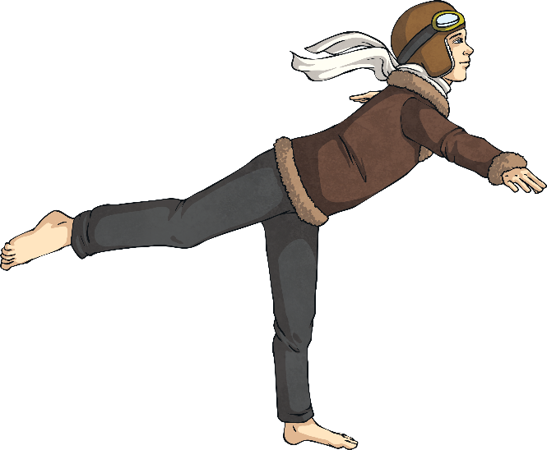
La grammaire du futur simple (Simple Future Tense)
This is how you say it in French.
Quand je serai grand, je serai aviateur !
What do you think the highlighted words mean?

Slide 19
La grammaire du futur simple (Simple Future Tense)
This is the simple future tense in French.
Infinitive
Present Tense (1st person)
Simple Future Tense (1st person)
être
je suis
je serai
(to be)
(I am)
(I will be)
What do you notice? How is it different to English?

Slide 20
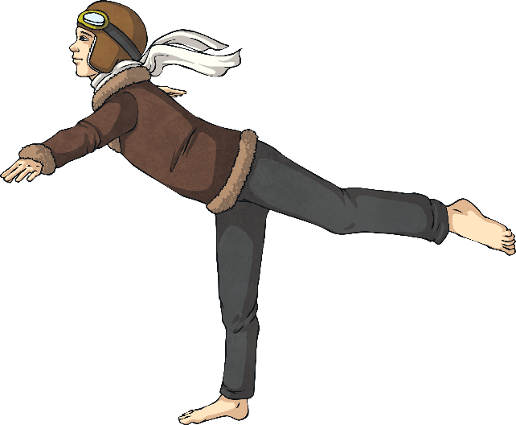
La grammaire du futur simple (Simple Future Tense)
Quand je serai grand, je serai aviateur !
What do you notice? How is it different to English?

Slide 21

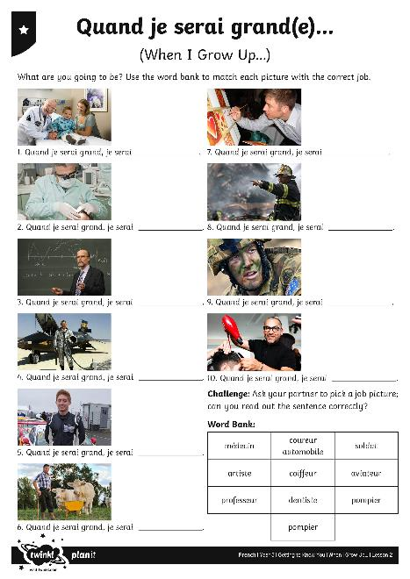
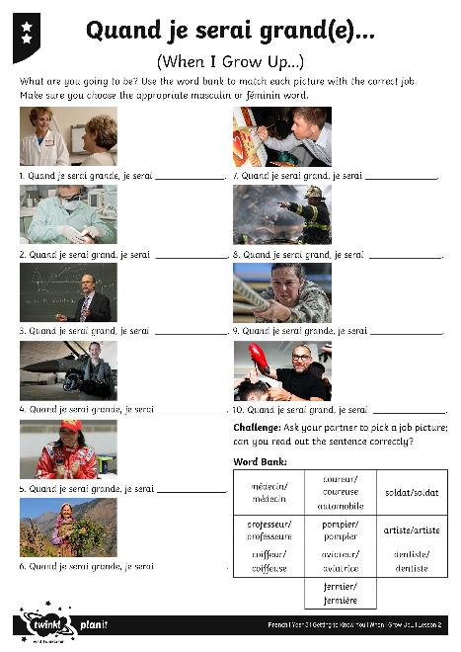
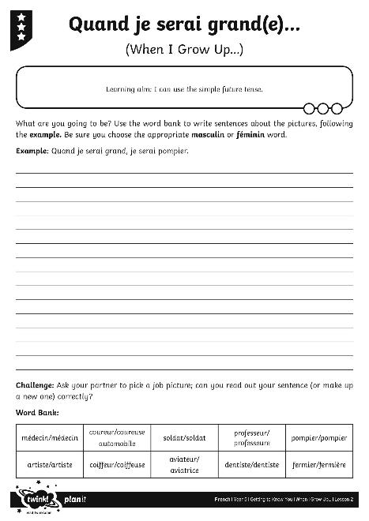
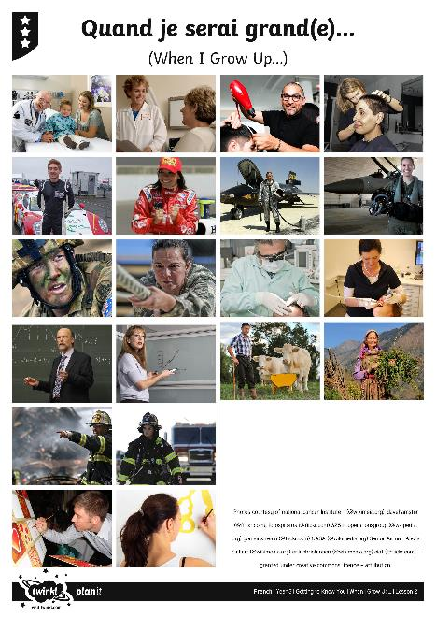
Quand je serai grand(e), je serai... (When I Grow Up, I’m Going to Be...)

Slide 22

Aim
I can use the simple future tense.
Success Criteria
I can use ‘je serai’ to refer to my future.
I can show how French future tense is different to English.
I can use the speaker’s body language to help me understand what they are saying.
I can listen and respond appropriately to what is said.

Slide 23


