Slide 1
Monday 1st March 2021
To read a set of instructions to make a set of Superhero cuffs..
To write a set of instructions on how to make a Superhero mask.

Slide 2
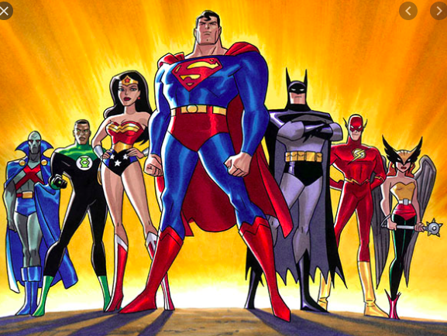
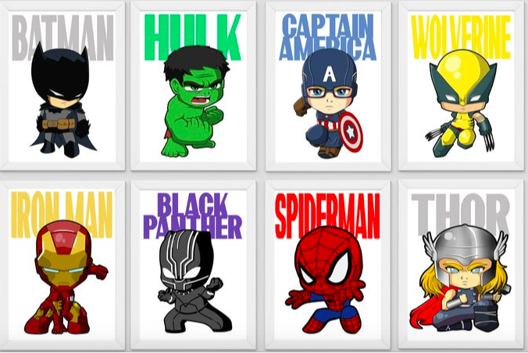
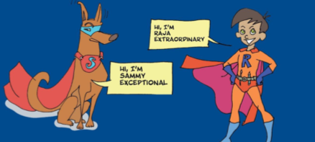
We are continuing our work on Superheroes.

Slide 3
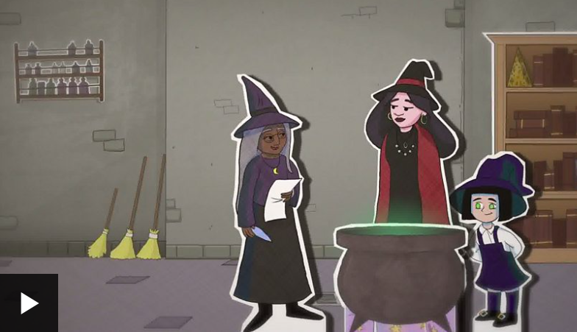

Slide 4
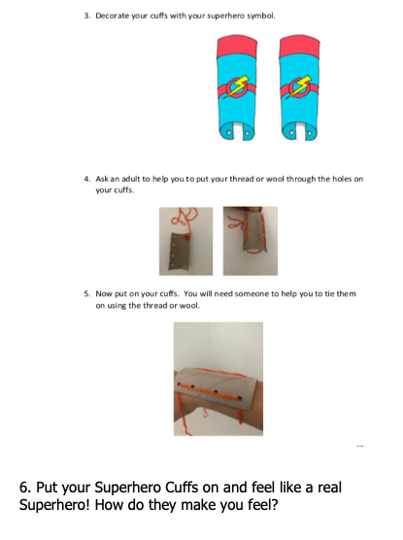
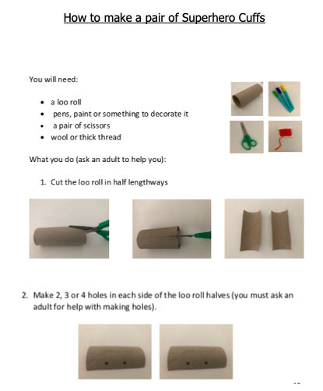
Read and follow the instructions on the following pages to make your own set of Superhero Cuffs. You will need a toilet or loo roll…

Slide 5
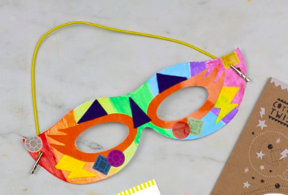
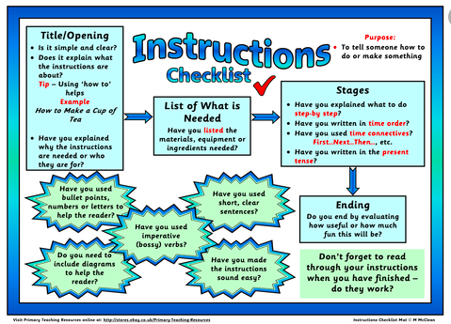
As an extra challenge why don’t you write your own set of instructions which show how to make a Superhero face mask?

Slide 6
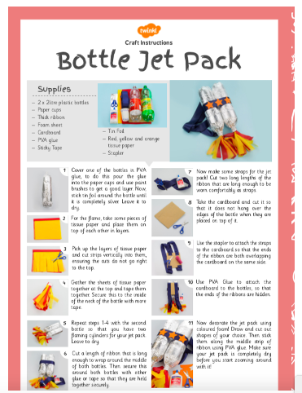
Why not try reading more instructions and create more superhero crafts as and when you have time…

Slide 8
Tuesday 2nd March 2021
-To experiment with different words when writing
verses in a poem.

Slide 9
Watch the video on How to write a poem;

Slide 10
Sammy has written the first two verses of a superhero poem.
He would like your help in order to finish it.

Slide 14
Wednesday 3rd March 2021
-To create a Superhero Pet.
-To draw and label a Superhero Pet.

Slide 15
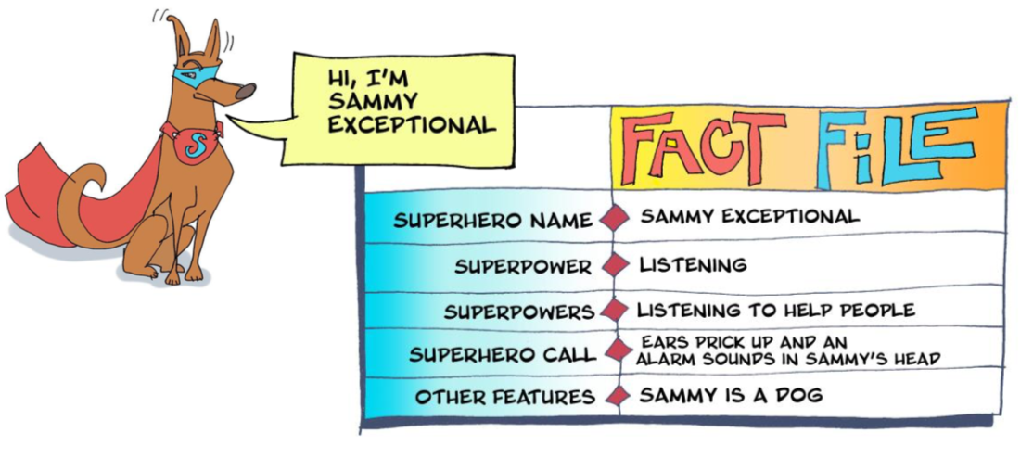

Slide 16
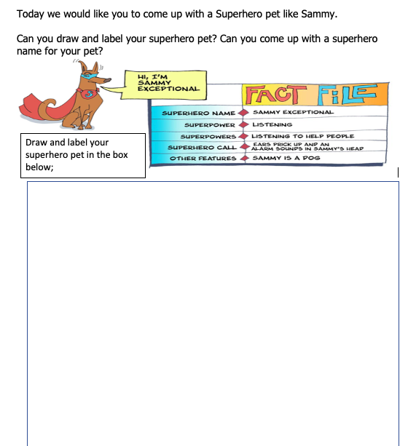

Slide 18
Thursday 4th March 2021
To read a new Superhero story.
To answer questions on it.

Slide 20
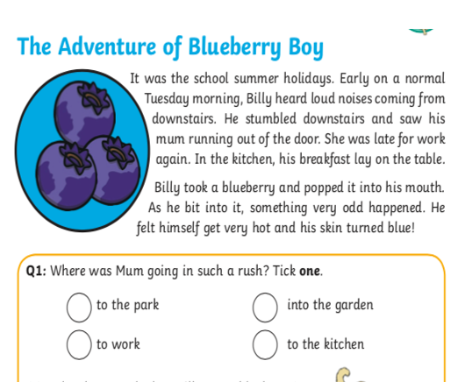
Can you read the story of Blueberry Boy and answer questions on it?

Slide 22
Friday 5th March 2021
To design, write and create a comic strip based on our own Superhero character.

Slide 23
Invention Time
Today we would like you to write a superpower rescue challenge all of your own.
Watch the clip; https://www.bbc.co.uk/newsround/34759926
https://www.bbc.co.uk/bitesize/topics/zkgcwmn/articles/zbk47nb

Slide 24
You could use the original Playground Rescue story or The Adventures of Blueberry Boy to help you. You may want to magpie some ideas! Use the superhero character you based yourself on, could you also include the pet superhero you created too? Could you draw the story as a cartoon? We have included a cartoon strip for you to use…Draw pictures and write sentences in each box. Can you use speech bubbles for characters speech?

