Slide 3
1) 5 + 5 + 5 + 5 = 4 + 4 + 4 + 4 + 4 =
5 $×$ 4 $=$ 4 $×$ 5 $=$
What is the area of this shape?
3) What shapes are these? What are their areas?

Slide 4
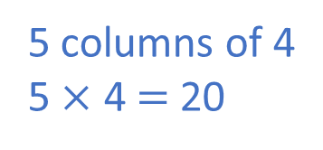
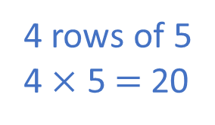
1) 5 + 5 + 5 + 5 = 4 + 4 + 4 + 4 + 4 =
5 $×$ 4 $=$ 4 $×$ 5 $=$
What is the area of this shape?
3) What shapes are these? What are their areas?
20
20
20
20
1
2
3
4
5
20 squares
6
7
8
9
10
11
12
13
14
15
4 rows of 5
4 $×$ 5 $=$ 20
5 columns of 4
5 $×$ 4 $=$ 20
16
17
18
19
20
rectangle
square
12 squares
9 squares

Slide 6
What is the area of this shape?
Have a think
1
2
3
4
5
6
7
7 squares
Make another shape with the same area.

Slide 7
Draw a shape on the grid
with an area of 5 squares.
Have a think

Slide 8
Draw a shape on the grid
with an area of 5 squares.
Have a think
Do you think Tiny is correct?

Slide 9
Draw a shape on the grid
with an area of 5 squares.
Have a think
Do you think Tiny is correct?

Slide 10
Draw a shape on the grid
with an area of 5 squares.
Have a think
Do you think Tiny is correct?

Slide 11
Have a go at questions 1 - 4 on the worksheet

Slide 12
Change the shape to make it a square with an area of 9 squares.
Have a think

Slide 13
Have a go at questions 5 - 8 on the worksheet

Slide 14
How many different rectilinear shapes can be made using seven squares?

Slide 15
Have a go at question 9 on the worksheet

