Slide 1


Science
Sound
Year One
Science | Year 4 | Sound | Higher and Lower | Lesson 3

Slide 2
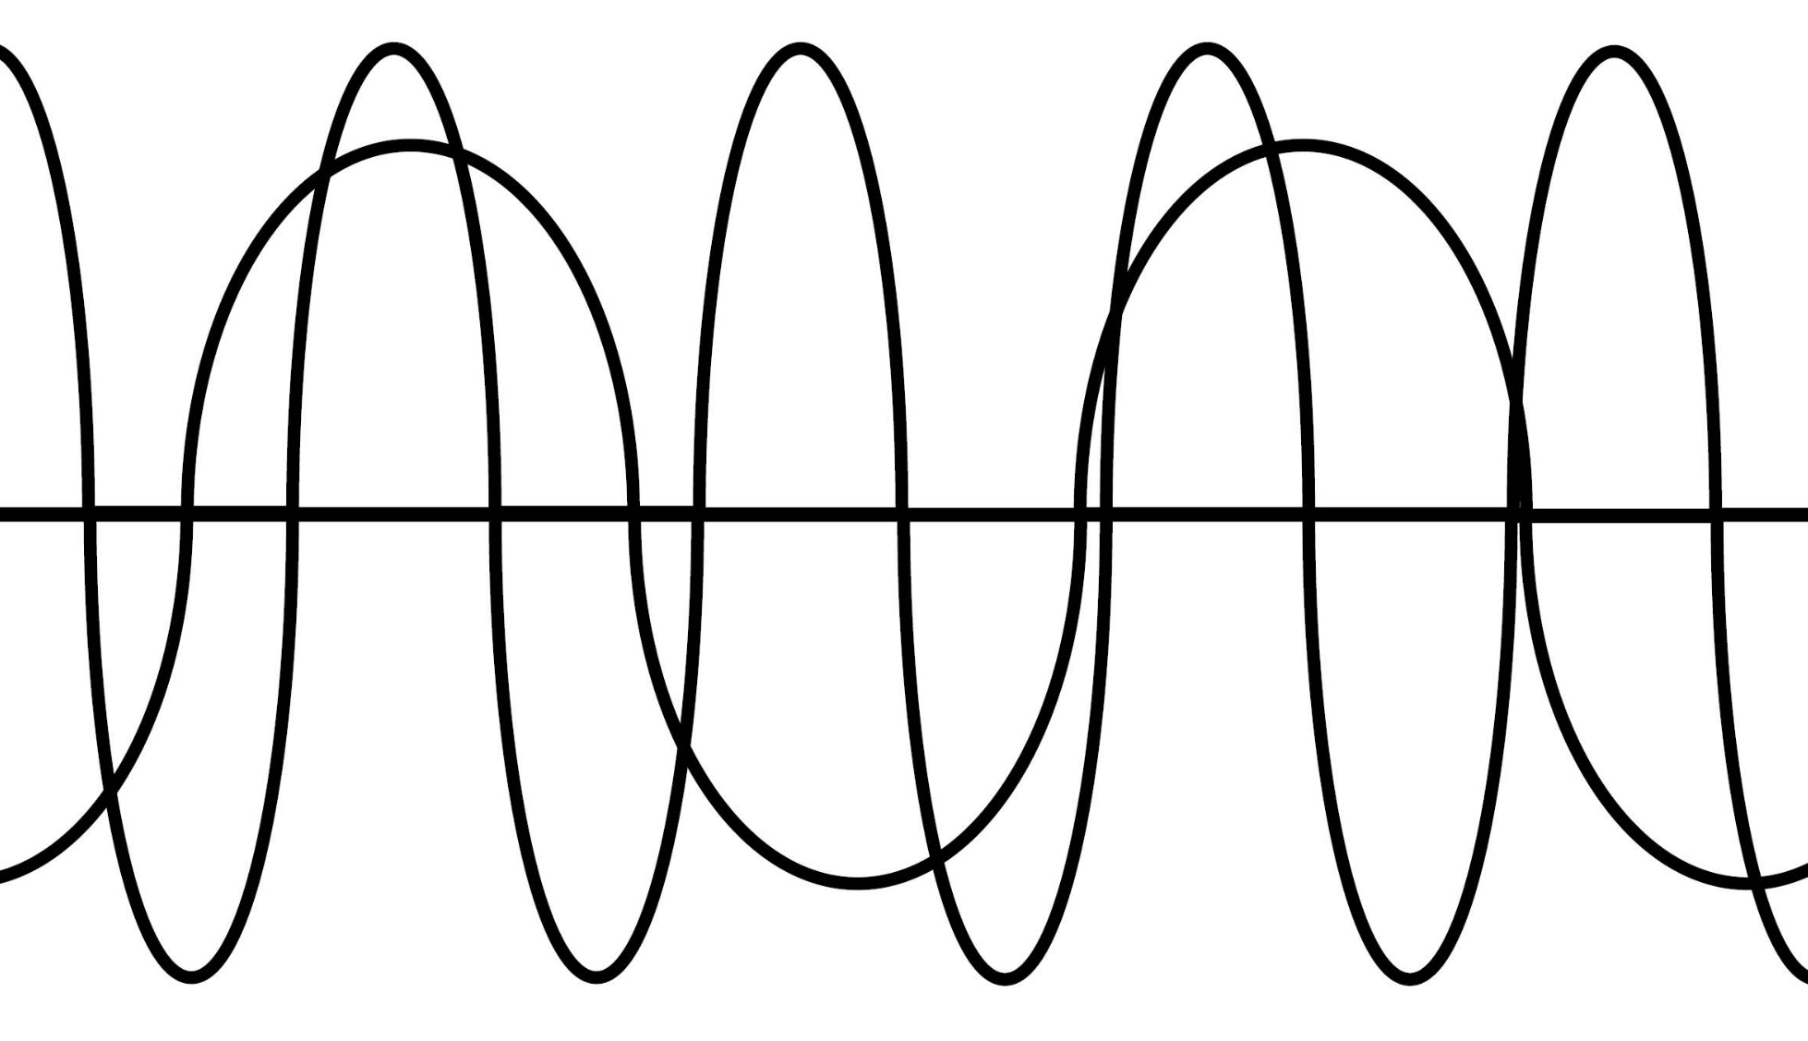

Higher and Lower

Slide 3
Aim
I can explore ways to change the pitch of a sound.
Success Criteria
I can identify and describe high and low sounds.
I can observe and describe patterns between the pitch of a sound and features of the object that made the sound.
I can create a musical instrument and explain how it makes high and low sounds.

Slide 4

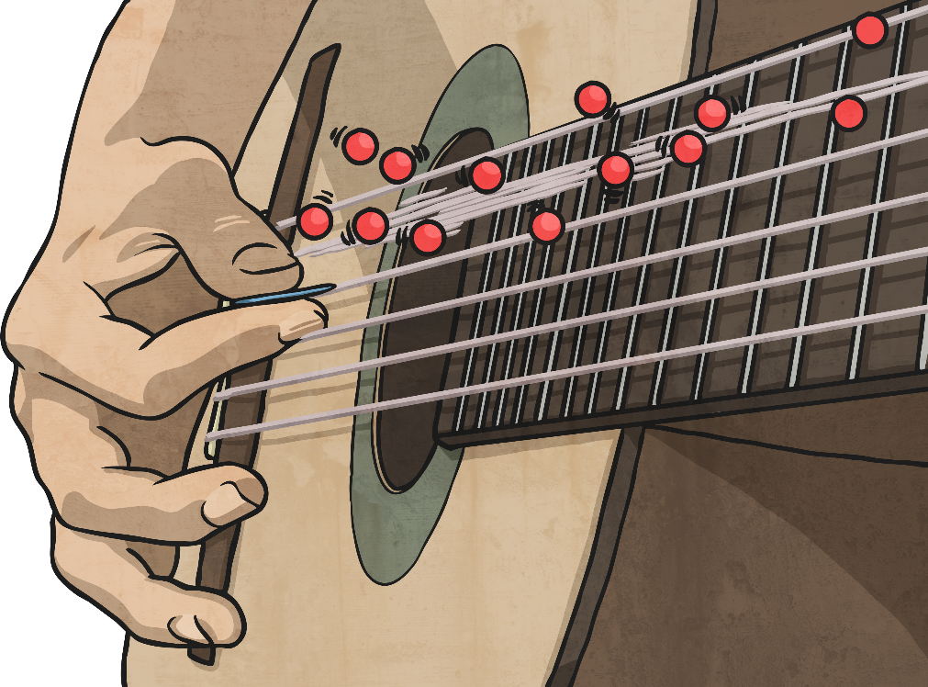
Different Sounds
Sounds can be loud or quiet. Bigger vibrations make louder sounds, and smaller vibrations make quieter sounds.
There are other ways sounds can be different.
Can you make a high sound? How about a low sound? Show your partner now!

Slide 5
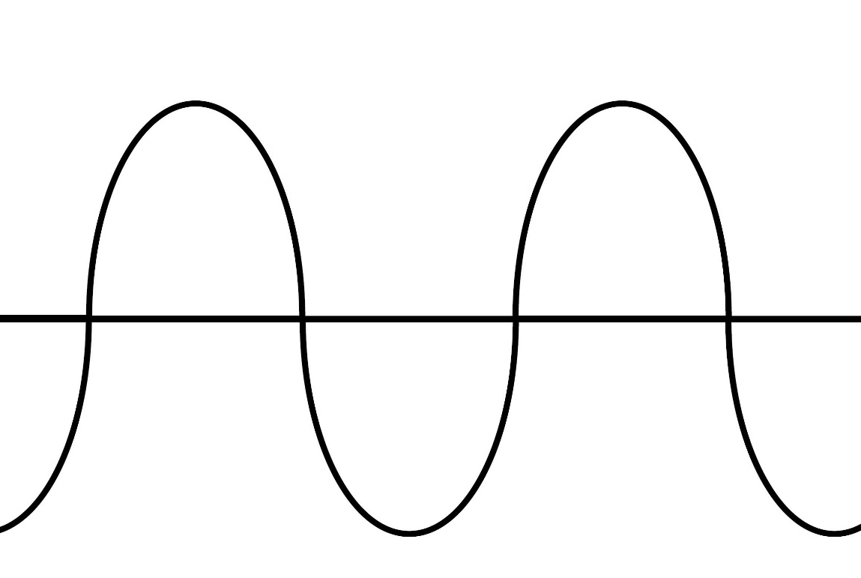
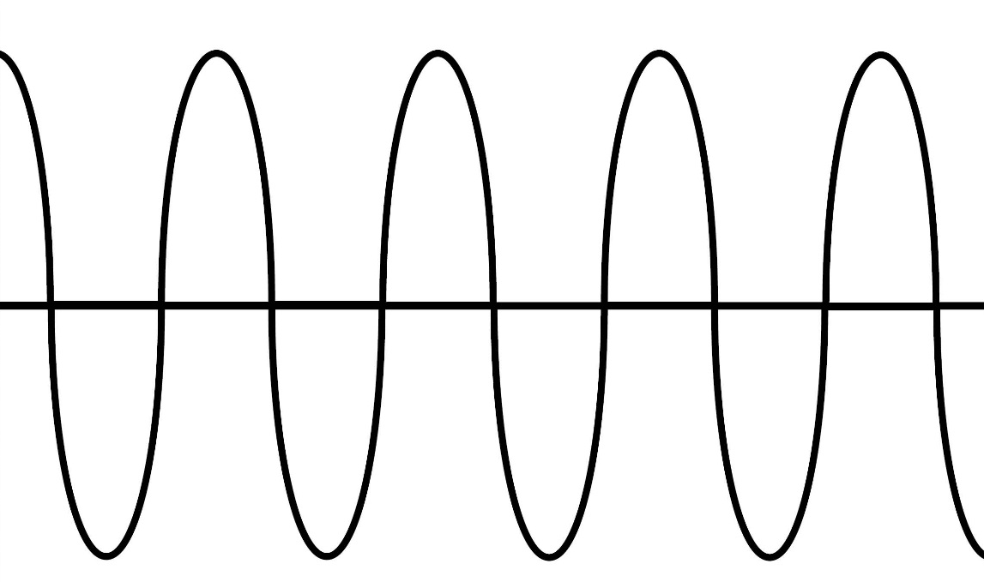
Different Sounds
High and low are words to describe the pitch of a sound.
The pitch of a sound is different to the amplitude.
Amplitude is a measure of how loud or quiet a sound is, and pitch is a measure of how high or low a sound is. High sounds can be quiet or loud, and low sounds can be quiet or loud too!
Amplitude
Pitch

Slide 6

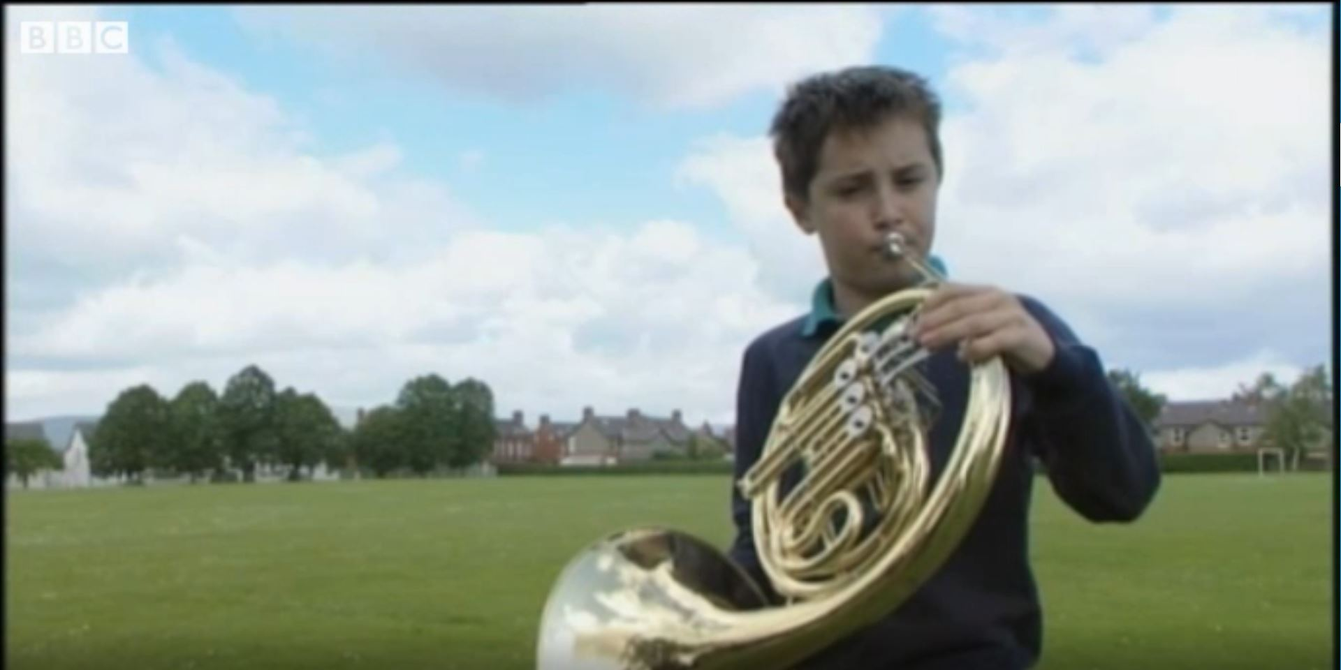
Different Sounds
Watch this clip to see if you can hear and identify how different musical instruments create different sounds.
Click on this image to play the video in a new window.
Notes:
Teacher Note - Please check your volume is set to the appropriate level for this video. Please do not let the next video automatically play at the end of the clip. Please check the content in this link, including any comments, is suitable for your educational environment before showing. Twinkl accepts no responsibility for the content of third party websites.

Slide 7
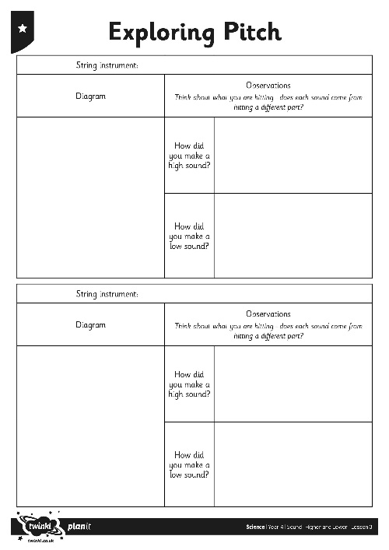
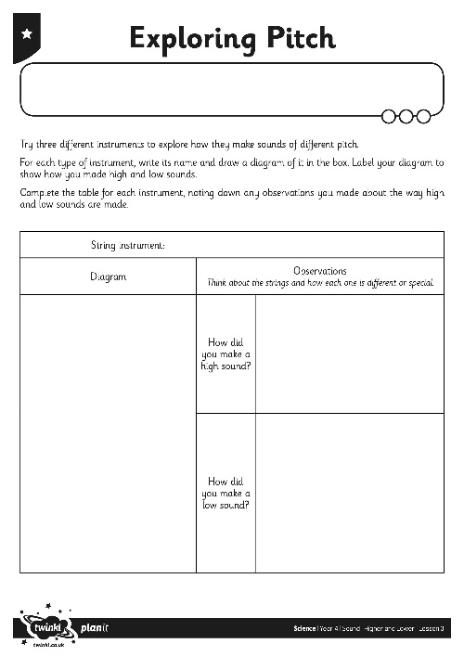
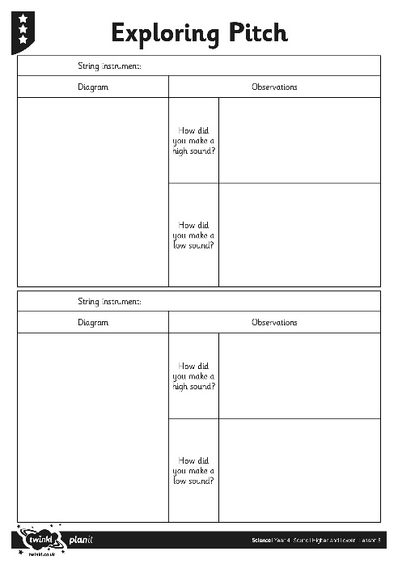

Exploring Pitch
How did you do? Could you hear the different pitches?
You are going to explore how high and low sounds are made, and see if you can spot any patterns when looking at how different instruments can create sounds of different pitches.
You will try three different activities and note down any observations about how the sounds change on your Exploring Pitch Activity Sheet.

Slide 8
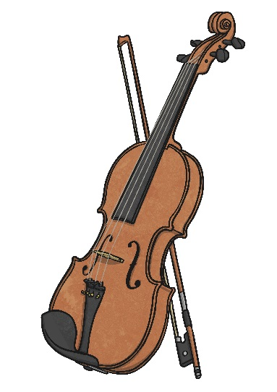
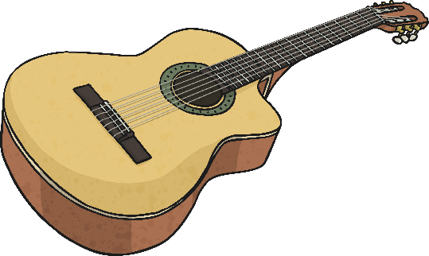
Exploring Pitch - Strings
Use the string instrument to play different sounds. Can you hear high and low sounds?
Look at the instrument. What do you notice about the way it makes high sounds?
What can you observe about the way it makes low sounds?
Draw a diagram of the string instrument, labelling how you played high sounds and low sounds.
Complete the table, noting down any observations you made about the way high and low sounds are made.

Slide 9
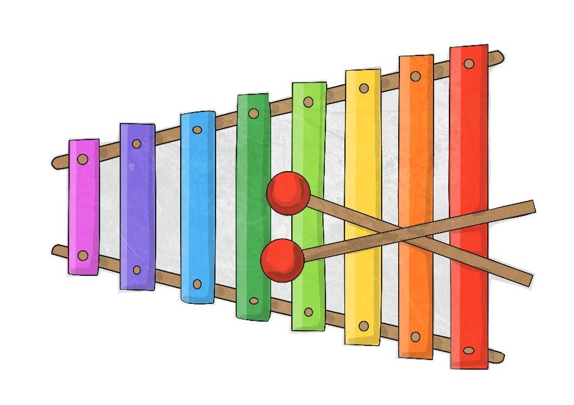
Exploring Pitch - Percussion
Play the percussion instrument. Can you make it make high sounds and low sounds?
Do you notice or observe anything about how high and low sounds are made? Look at the shape or size of the bars, keys, skin or the whole instrument.
Draw a diagram of the percussion instrument, labelling how you played high sounds and low sounds.
Complete the table, noting down any observations you made about the way high and low sounds are made.

Slide 10
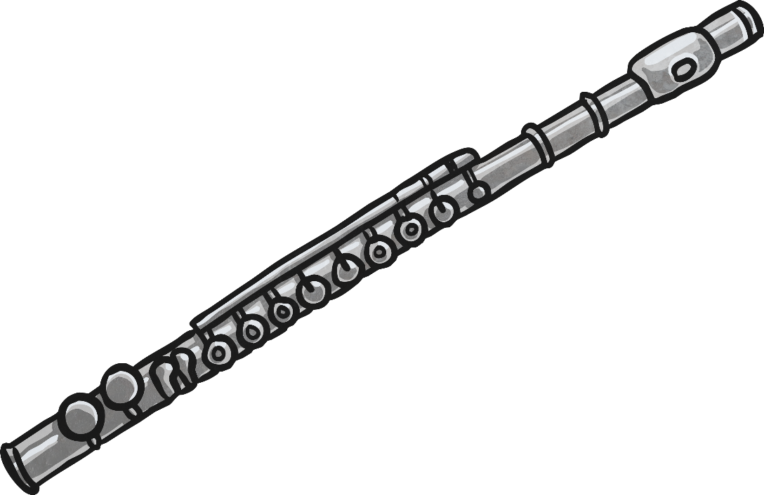
Exploring Pitch - Wind
Try playing the wind instrument. How are high and low sounds made?
Look carefully at how you create the different sounds. What do you have to do to make a high sound? What do you do differently to make a low sound?
Draw a diagram of the wind instrument, labelling how you played high sounds and low sounds.
Complete the table, noting down any observations you made about the way high and low sounds are made.

Slide 11

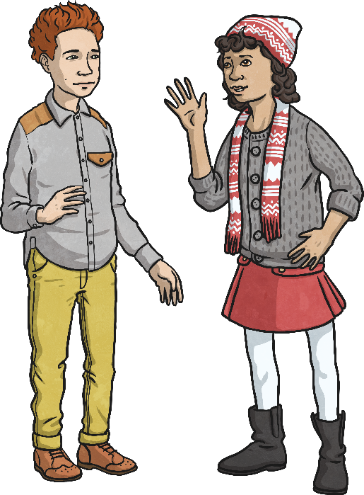
Changing Pitch
Look at your observations about how pitch is changed in the different instruments
you explored.
Do you notice any patterns? Are there any links between the features of the instrument and the pitch of the sound?
Talk to your partner about what you notice.

Slide 12
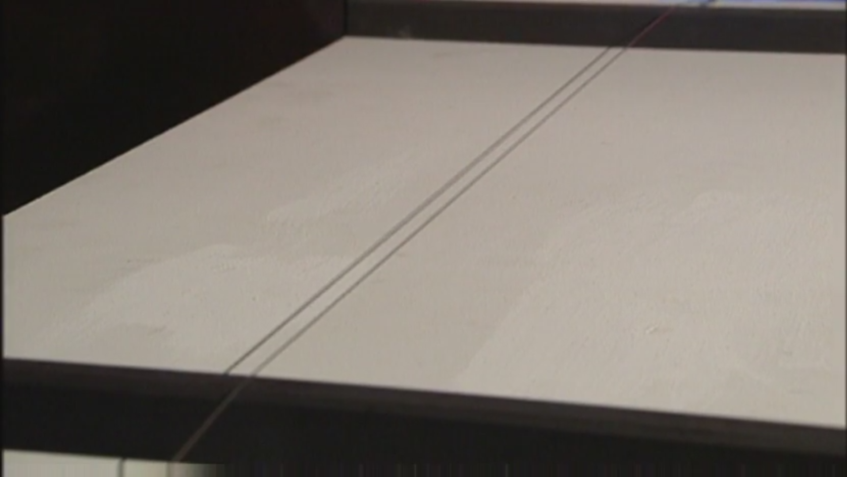
Changing Pitch
Watch this clip explaining how the pitch of a sound can be changed. Did you observe or notice anything similar?
Click on this image to play the video in a new window.

Slide 13
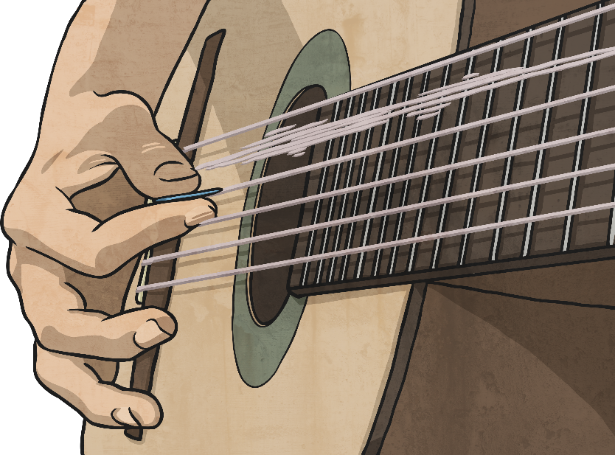
Changing Pitch
On a string instrument, there are several ways to change the pitch.
The tighter, thinner or shorter the string is, the higher pitched the sound will be and the looser, thicker or longer the string is, the lower the sound will be.
Faster vibrations will make a sound higher, and slower vibrations will make a sound lower.
The ways of changing the strings all change the vibrations, which in turn change the pitch of the sound.

Slide 14
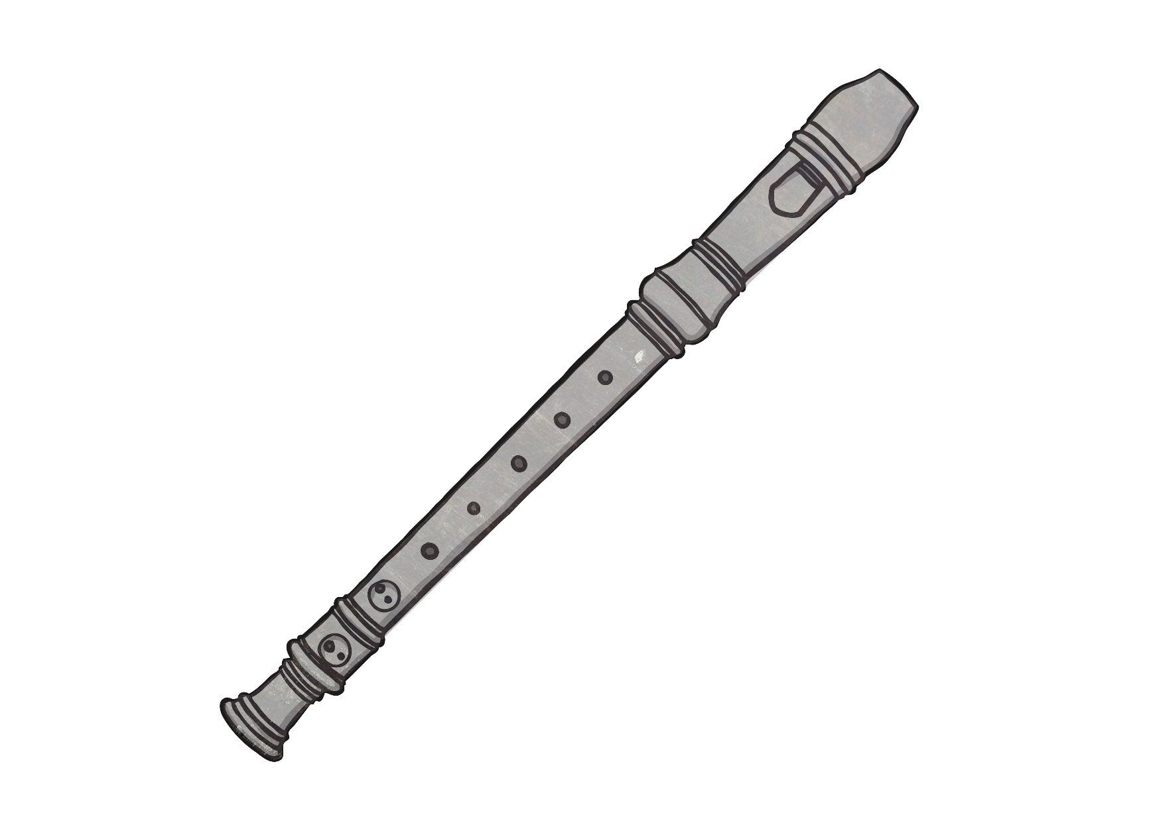
Changing Pitch
On a wind instrument, the column of air inside the instrument is what vibrates to cause the sound.
Shortening the column of air will create a higher sound, and lengthening the column of air will create a lower sound.
This can be done with a sliding mechanism, such as in a trombone.
The length of the column of air can be changed by opening or closing holes in the side of the tube, such as in a recorder.

Slide 15
Changing Pitch
In a percussion instrument, the surface or object that is struck is the thing that vibrates to create the sound.
The pitch of a percussion instrument can be changed in different ways.
There may be a series of different length bars or keys, such as in a xylophone. The shorter the bar or key, the higher the pitch will be.
There may be different instruments of different sizes. For example, when playing hand bells the musician will have a set of bells to play. The smaller the bell, the higher the pitch. The larger the bell, the lower the pitch.
In a drum, the tighter the skin, the higher the pitch will be.
A thinner skin will make a higher pitched sound and a thicker skin will make a lower pitched sound.

Slide 16
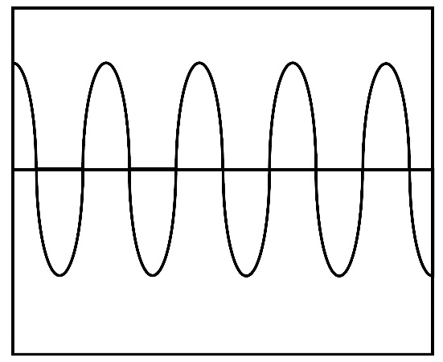
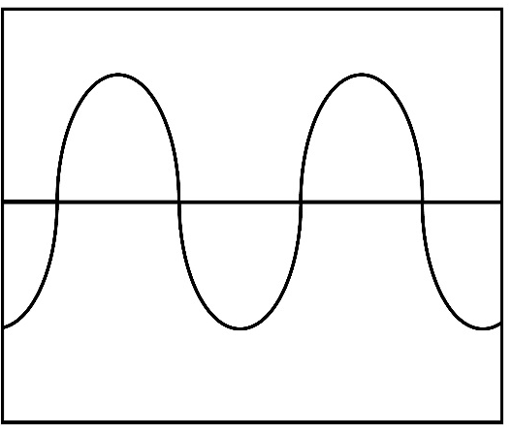
Changing Pitch
Do you notice anything in common with how the different instruments create sounds of different pitches?
Generally, the shorter, tighter or thinner the object is, the higher the pitch of the sound will be. This is because the vibrations will be faster. The longer, looser or thicker the object is, the lower the pitch of the sound will be. This is because the vibrations will be slower.

Slide 17

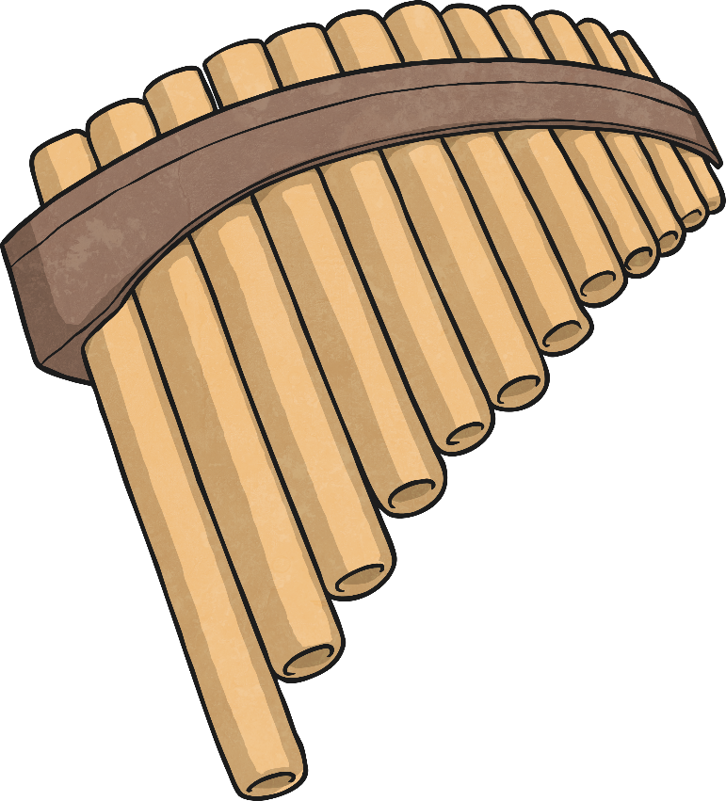
Pan Pipes Challenge
Your challenge is to create a set of pan pipes that will create sounds of different pitches, and explain how to change the pitch.
You will use straws, scissors, sticky tape and string to make the pan pipes.

Slide 18
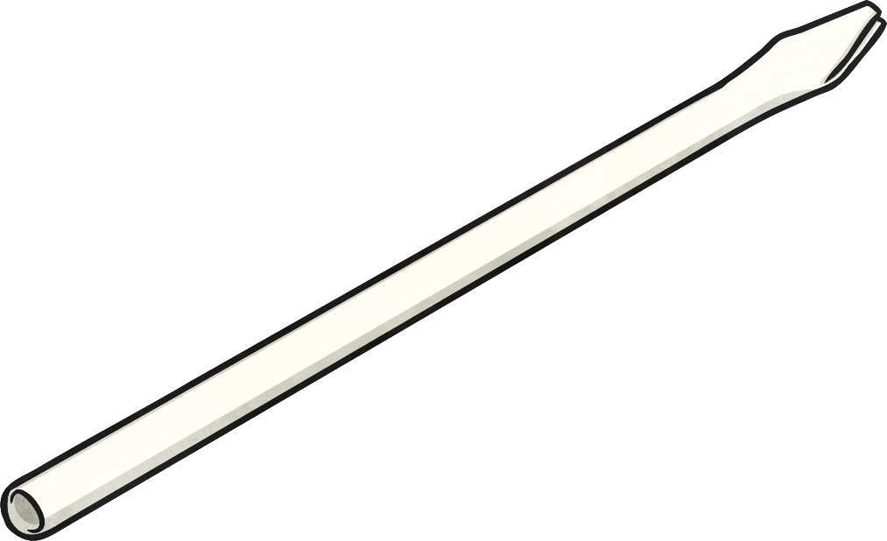
Pan Pipes Challenge
Flatten the end 2cm of each straw, and cut a triangle in the end, like this.
Place the triangular end of the straw in your mouth and blow hard through the straw to make a sound. You may have to try few times to make the sound!
Use several straws to make your set of pan pipes. Stick or tie them together. Think about what you have learnt in order to make each straw make a different pitched sound.

Slide 19
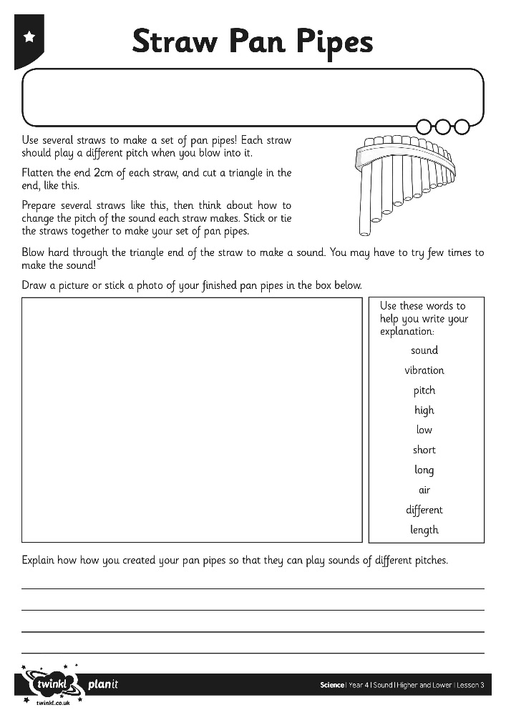
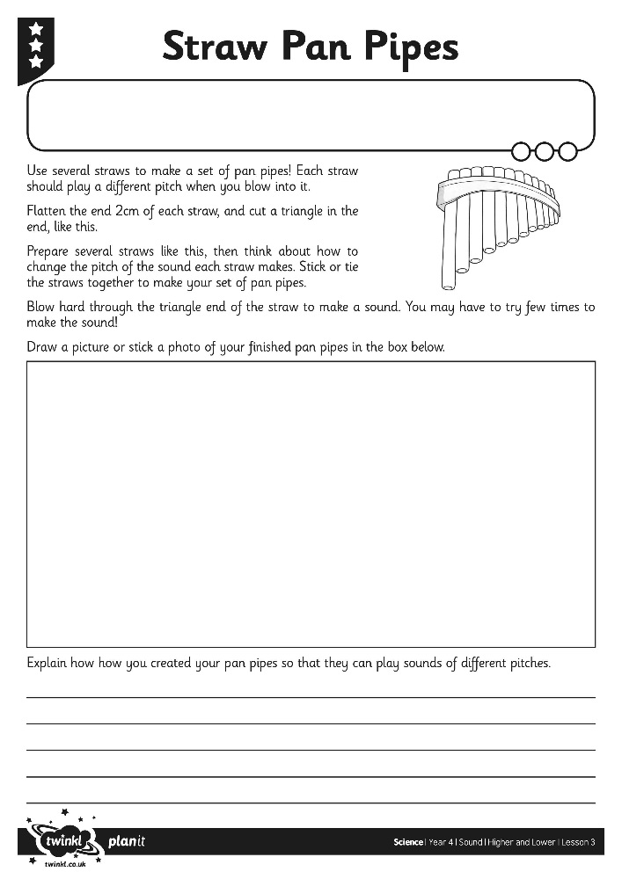
Pan Pipes Challenge
Draw a picture of your set of pan pipes and explain how you can create sounds of different pitches on your Straw Pan Pipes Activity Sheet.

Slide 20

Aim
I can explore ways to change the pitch of a sound.
Success Criteria
I can identify and describe high and low sounds.
I can observe and describe patterns between the pitch of a sound and features of the object that made the sound.
I can create a musical instrument and explain how it makes high and low sounds.

