Slide 2
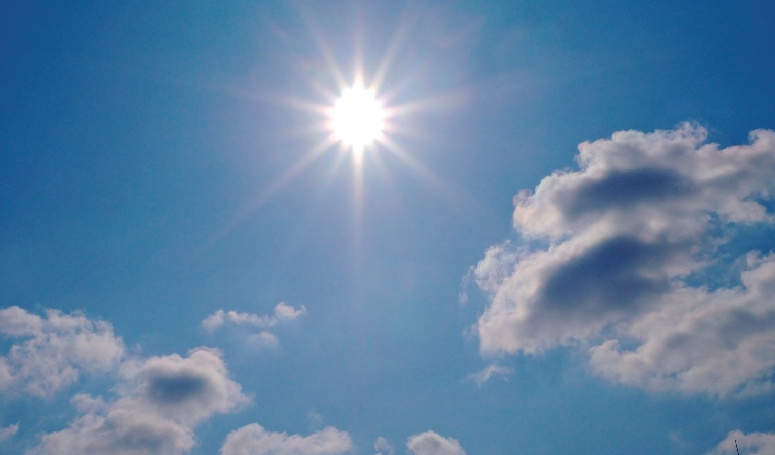
Sun
The sun is a star made of burning gas.
The sun gives us daylight and it also gives us heat.
When it is a sunny day you can feel the warmth of the sun on your skin.
Photo courtesy of (Masahire Yochimi @flickr.com) - granted under creative commons licence – attribution

Slide 3
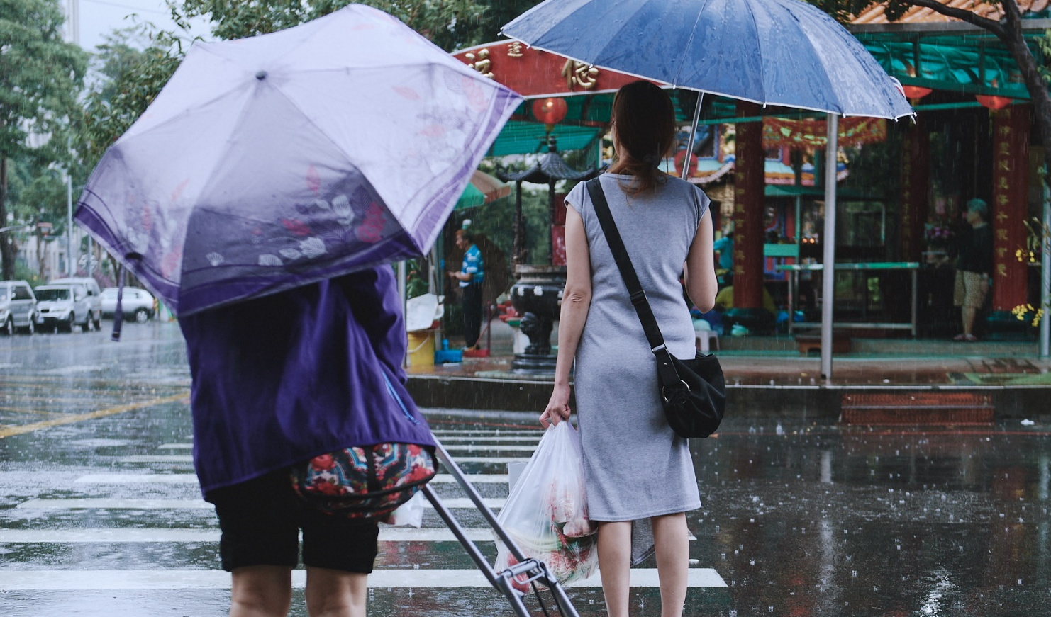
Rain
When you see very dark clouds in the sky, they are carrying lots of tiny drops of water.
When some of these drops of water fall from the clouds to the ground, it is raining.
Photo courtesy of (YELLOW Mao. 黃毛, Photographer @flickr.com) - granted under creative commons licence – attribution

Slide 4
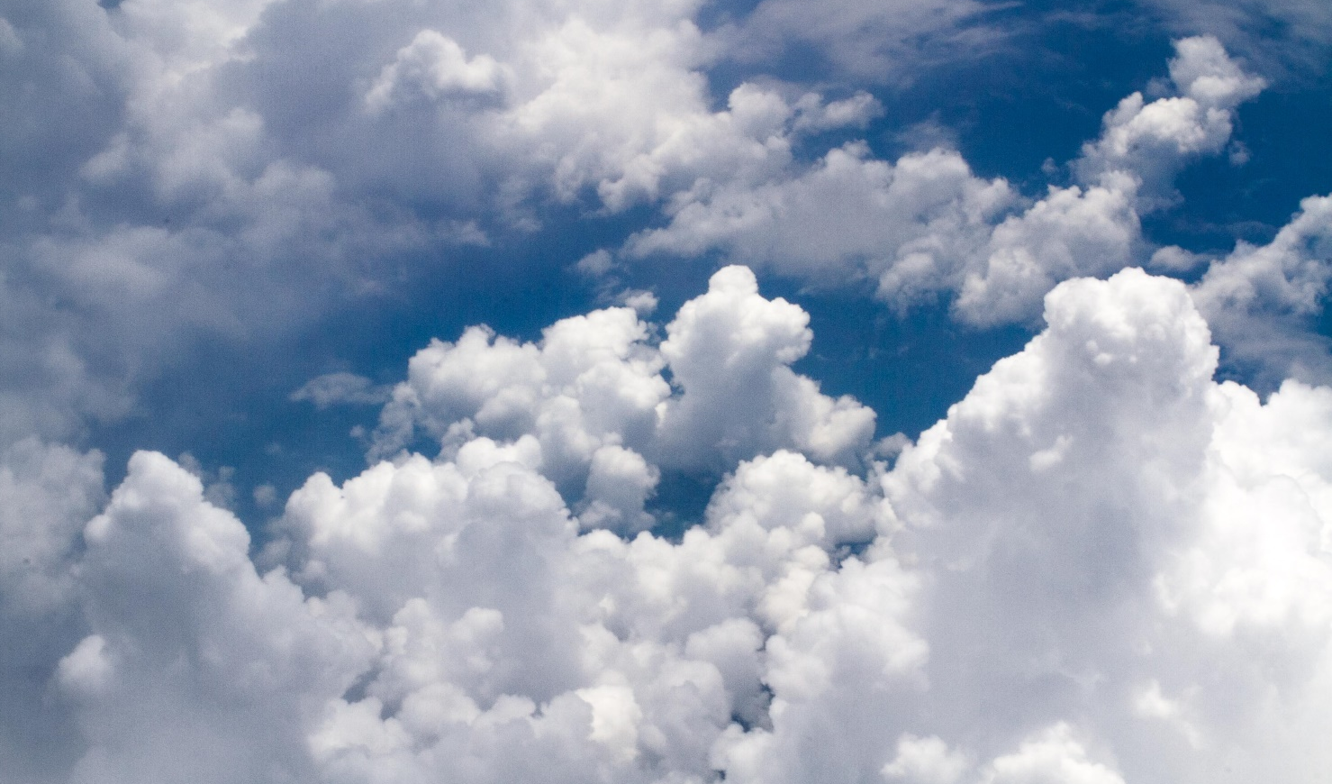
Clouds
Clouds are made up of lots of tiny drops of water.
Clouds can be different shapes and sizes.
You can also have different coloured clouds.
Some clouds are white and some can be grey.
Photo courtesy of (NJ Lee @flickr.com) - granted under creative commons licence – attribution

Slide 5
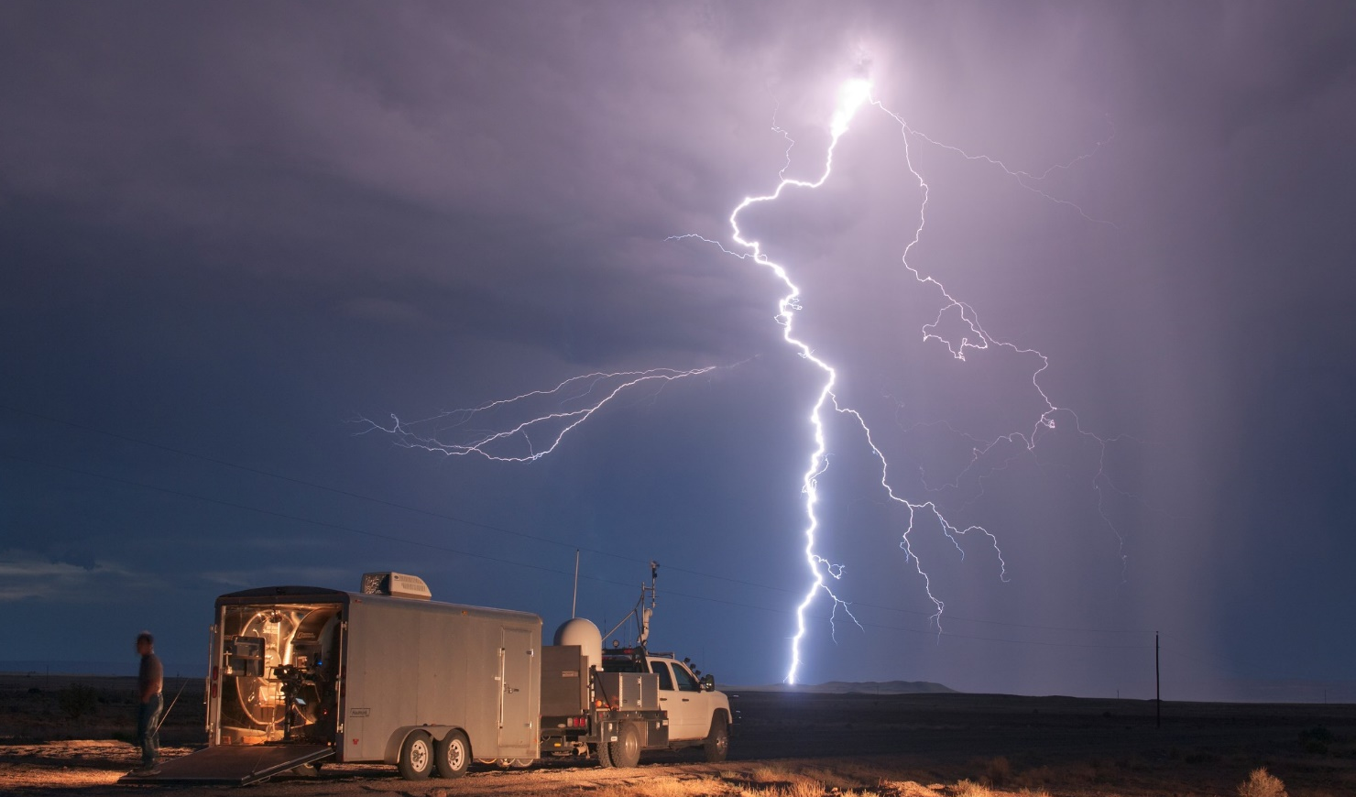
Lightning
Lightning is a large flash of electricity that goes all the way from the sky to the ground!
You normally see lightning during a thunder storm.
You may see a flash of lightning and then hear thunder!
Photo courtesy of (jaygohel @flickr.com) - granted under creative commons licence – attribution

Slide 6
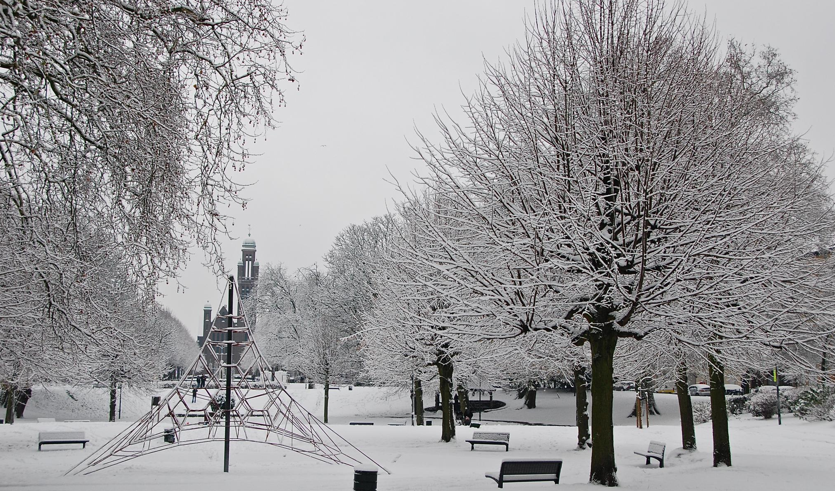
Snow
Snow is soft, white ice crystals that fall from the sky.
They can form a layer of white snow on the ground.
If it is too cold it will not snow but there might be ice.
Photo courtesy of (Stephane Mignon @flickr.com) - granted under creative commons licence – attribution

Slide 7
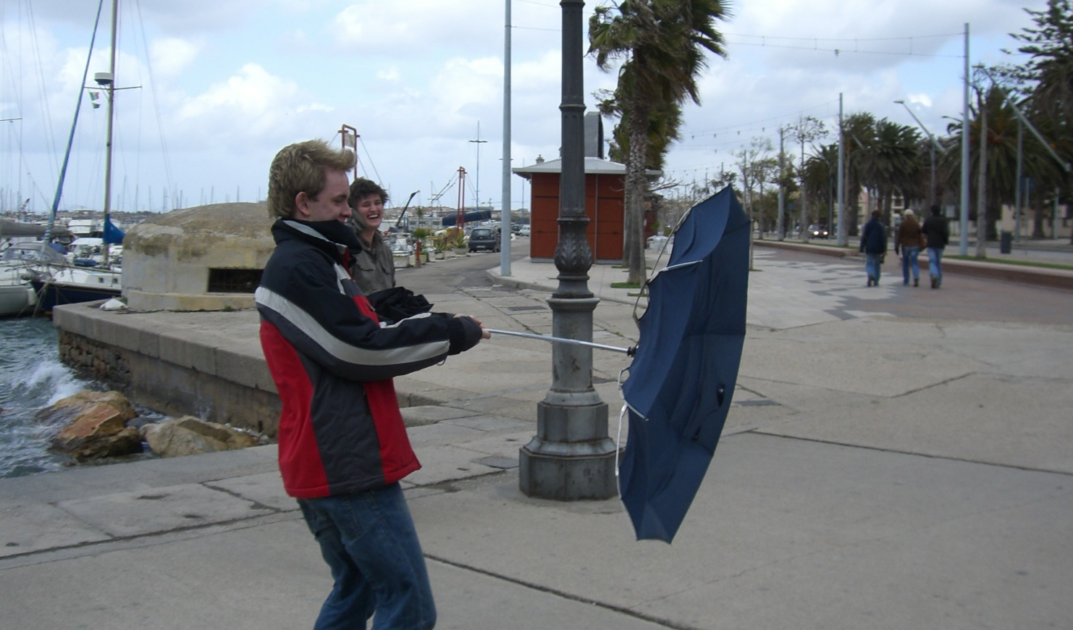
Wind
You cannot see wind because it is just moving air.
However, you can see the effect the wind has on different objects. You can see leaves and tree branches blowing in the wind. The speed and direction of the wind can be measured.
Photo courtesy of (Sam Wong @flickr.com) - granted under creative commons licence – attribution

Slide 8
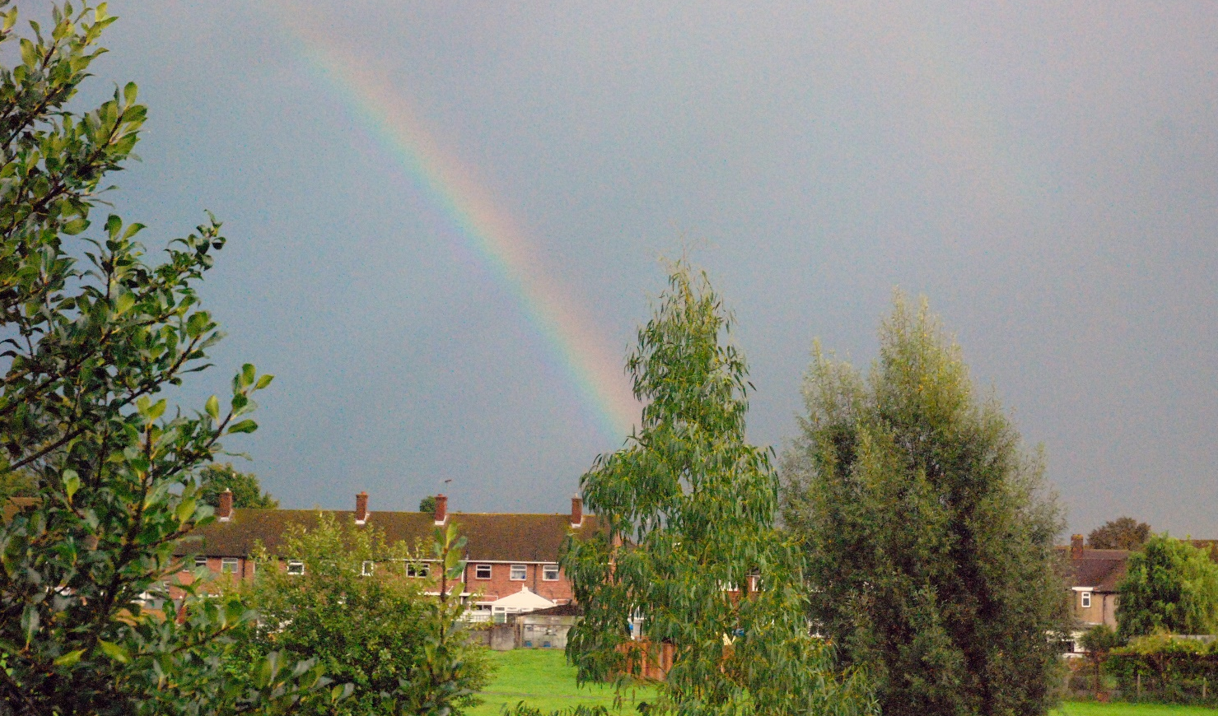
Rainbow
Rainbows appear when it is sunny in one part of the sky and raining in another.
The seven colours of the rainbow are red, orange, yellow, green, blue, indigo and violet.
Photo courtesy of (Allen Watkin @flickr.com) - granted under creative commons licence – attribution

Slide 9
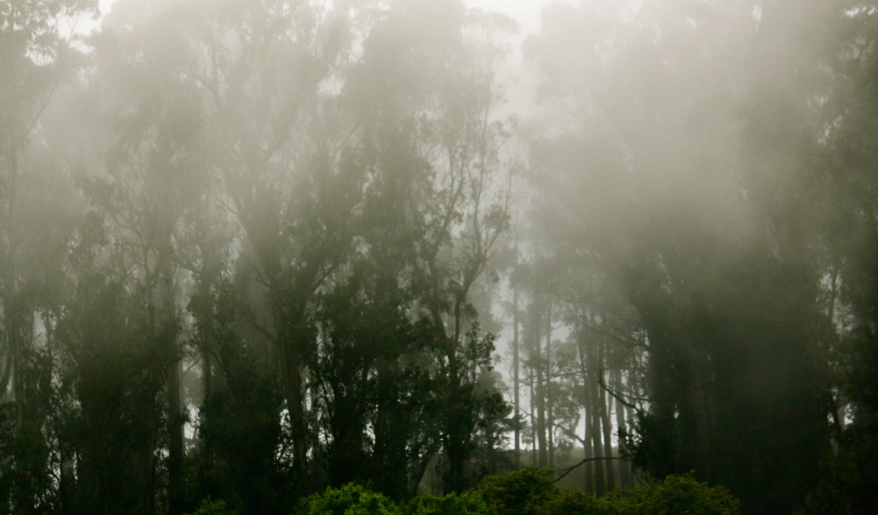
Fog
Fog is made up of lots of tiny drops of water.
It is like a cloud but instead of being in the sky it is just above the ground.
When it is a foggy day it can be hard to see what is around you.
Photo courtesy of (Shannon Elliott @flickr.com) - granted under creative commons licence – attribution

